Slide 1
Acoustic Transmission Loss through Periodic Elastic Multilayered Structures

Slide 2
Background and Motivation
In this model, two fluid domains are separated by a multilayer solid elastic structure. An acoustic pressure wave impacts the structure resulting in a reflected wave and a transmitted wave with a loss through the structure. This model investigates the transmission loss through the structure. The effects of incident angle, frequency and damping are studied.
Important features used: Acoustic-structure interaction with arbitrary incident angle, scattered field formulation, the perfectly matched layer (PML), and periodic Floquet boundary conditions.
The transmission through a single layer is described in the Acoustic Transmission Loss through Periodic Elastic Structures tutorial.

Slide 3
Geometry and Operating Conditions
k
water
Incident plane wave at angle θ, with wave vector k.
Infinite periodic structure
Infinite water domain
Multilayered solid material
θ
k
solids
dL
Floquet periodic condition
water
y
x
Modeled infinite periodic domain
L_{x}

Slide 4
Model Setup
The model equations are solved using the Acoustic-Solid Interaction, Frequency Domain multiphysics interface of the Acoustics Module.
The interface provides predefined multiphysics couplings between solids and acoustic domain as well as periodic Floquet conditions.
Add two integration operators to determine the average pressure at the top and bottom side of the solid. At the top both the incident (background) acpr.p_b and the reflected (scattered) acpr.p_s pressures are defined (because of the addition of the background pressure field option). On the bottom only the transmitted total field exists as acpr.p_b = 0.
Define variables for the reflection coefficient R and the transmission coefficient T. As well as the transmission loss TL and the absorption coefficient α. The TL and absorption are computed both based on the (plane wave) reflection/transmission coefficients and also based on integrating the intensity variables.

Slide 5
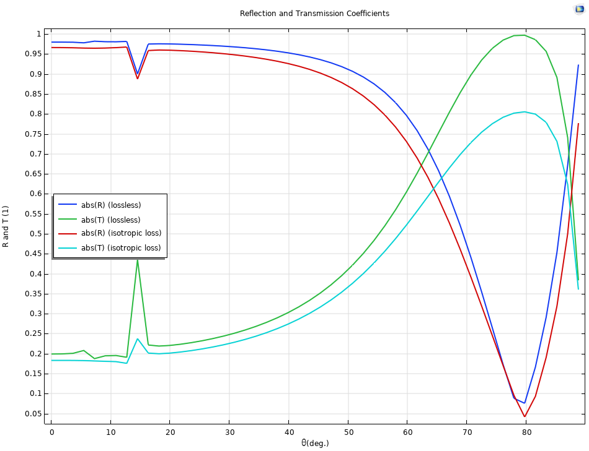
Reflection and Transmission Coefficients
Reflection and transmission coefficients for a multilayered structure with damping and without damping.

Slide 6
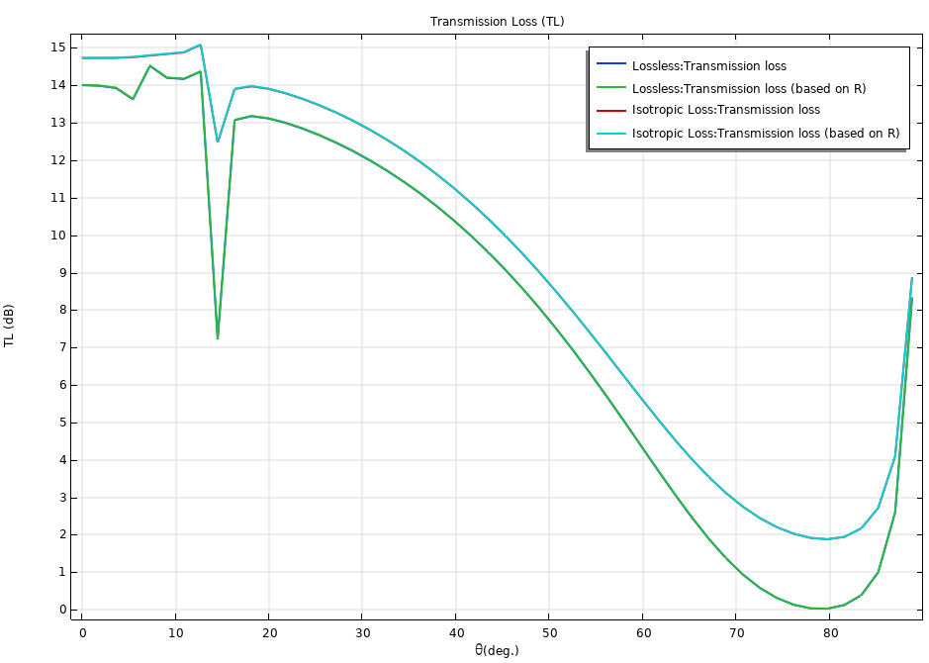
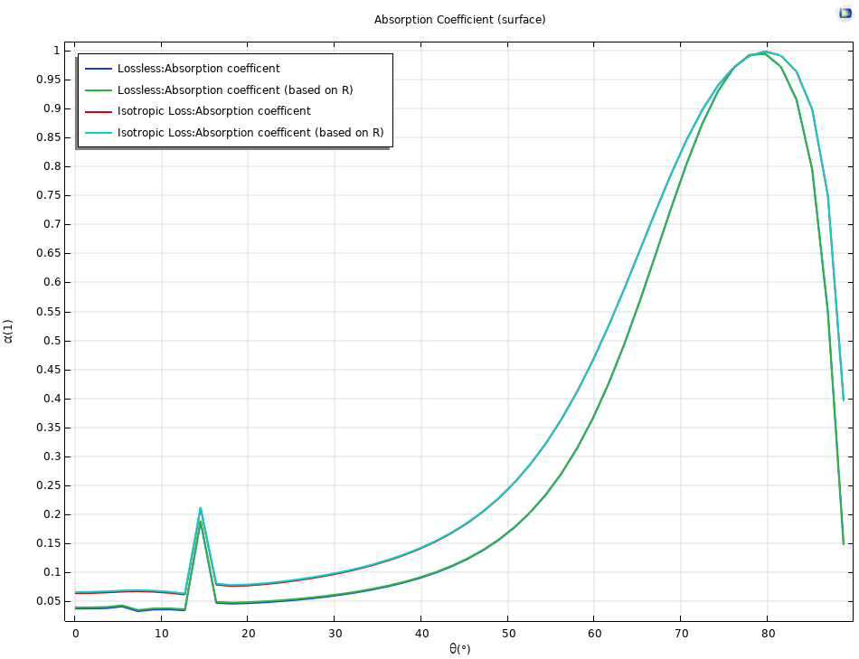
Transmission Loss and Absorption Coefficient

Slide 7
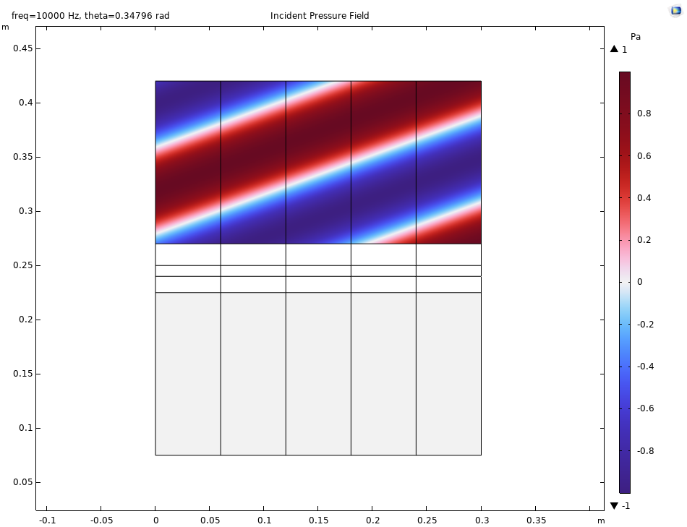
Results
Incident (background) pressure for an angle of incidence of 20 deg.

Slide 8
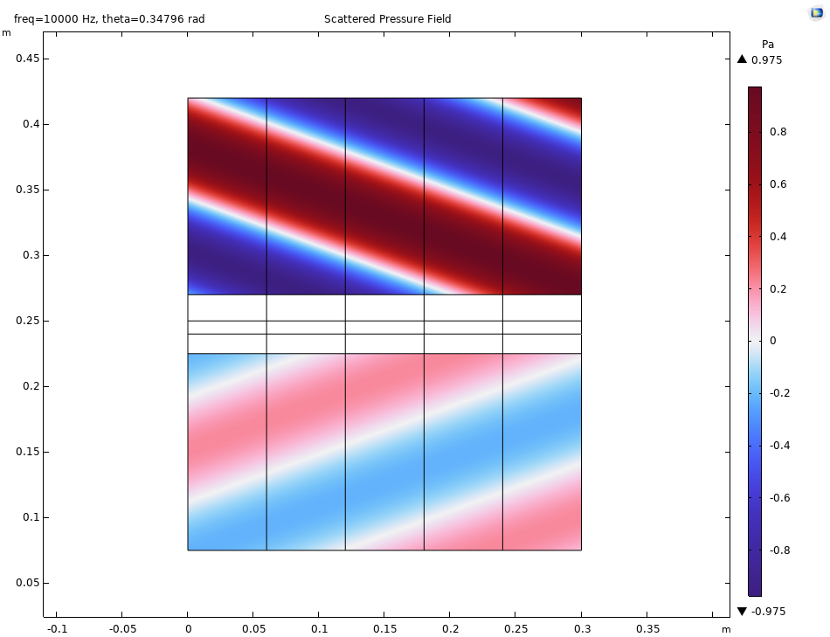
Results
Scattered (above) and transmitted (below) pressure for an angle of incidence of 20 deg.

Slide 9
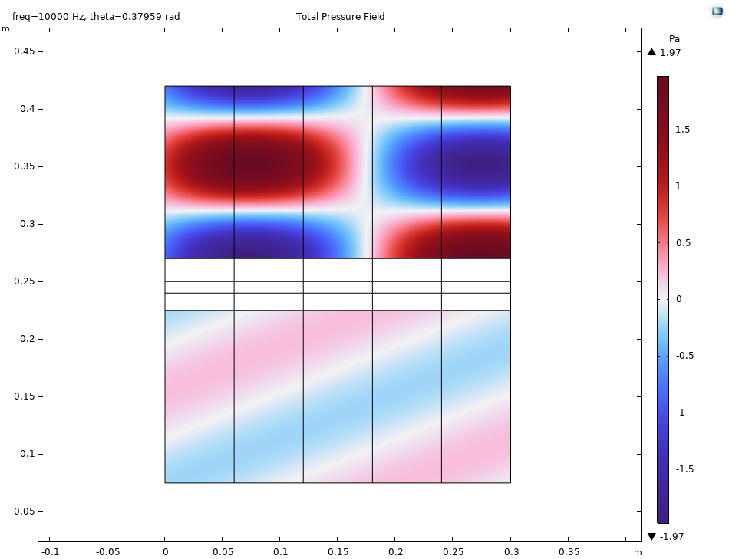
Results
Total pressure field for an angle of incidence of 20 deg.

Slide 10
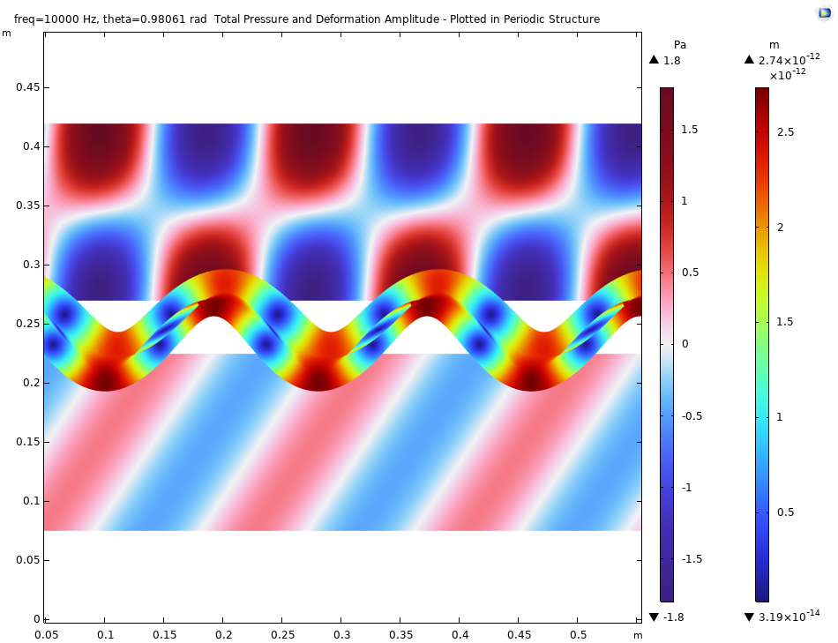
Results
Total pressure and deformation amplitude for an angle of incidence of 56 deg.

