Slide 1
A Phase Field Model of Fracture in Thermoelastic Solids
COMSOL 6.2

Slide 2
Introduction
This model demonstrates how to set up a phase field damage model to predict crack propagation in thermoelastic solids under large deformations
Several multiphysics effects are included:
  Thermal expansion
  Degradation of thermal conductivity with damage
  Heat convection across newly created crack surfaces
A robust segregated solver scheme with three decoupled steps:
  Update state variables from previous converged time step
  Solve for the phase field φ given the previous displacement field u and temperature T
  Solve for u given the updated phase field and previous temperature
  Solve for T given the updated phase field and displacement field
  Iterate 1–3 until convergence

Slide 3
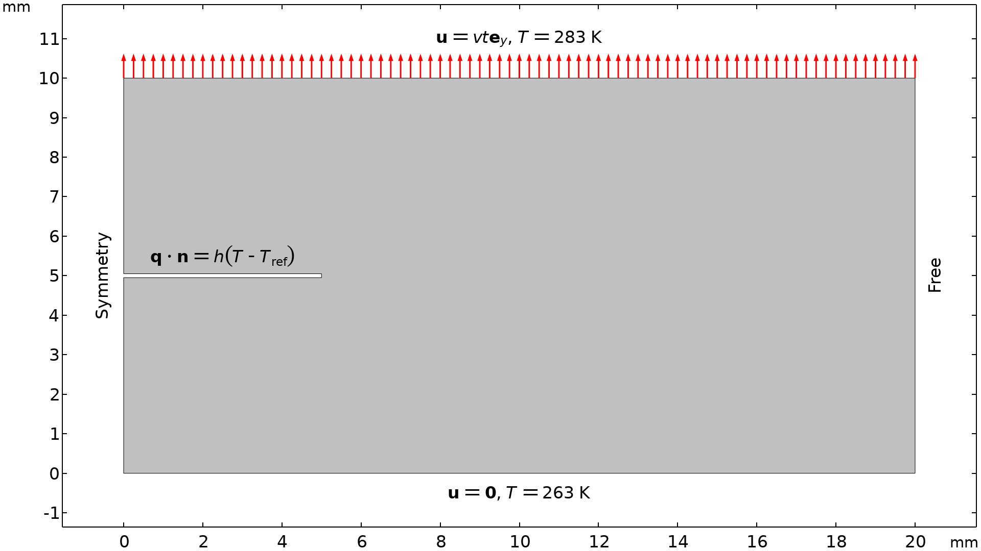
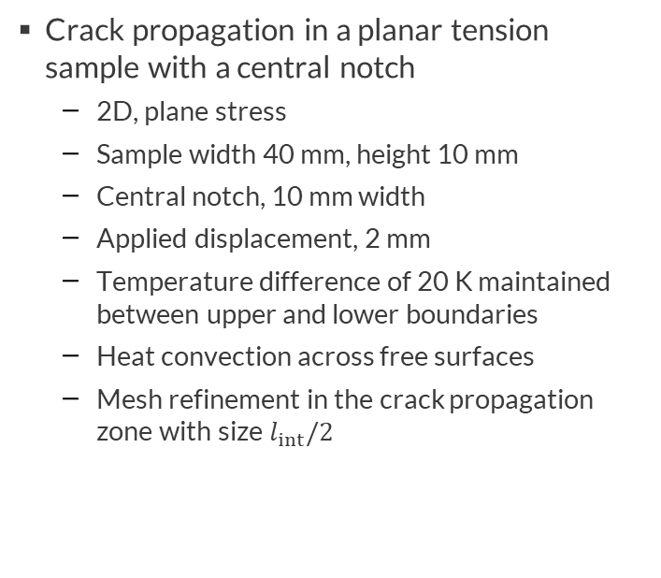
Crack Propagation in a Notched Tension Test
Crack propagation in a planar tension sample with a central notch
  2D, plane stress
  Sample width 40 mm, height 10 mm
  Central notch, 10 mm width
  Applied displacement, 2 mm
  Temperature difference of 20 K maintained between upper and lower boundaries
  Heat convection across free surfaces
  Mesh refinement in the crack propagation zone with size $l_{int}/2$
Example inspired by L.-M. Schänzel, Phase Field Modeling of Fracture in Rubbery and Glassy Polymers at Finite Thermo-Viscoelastic Deformations, PhD Thesis, University of Stuttgart, 2015

Slide 4
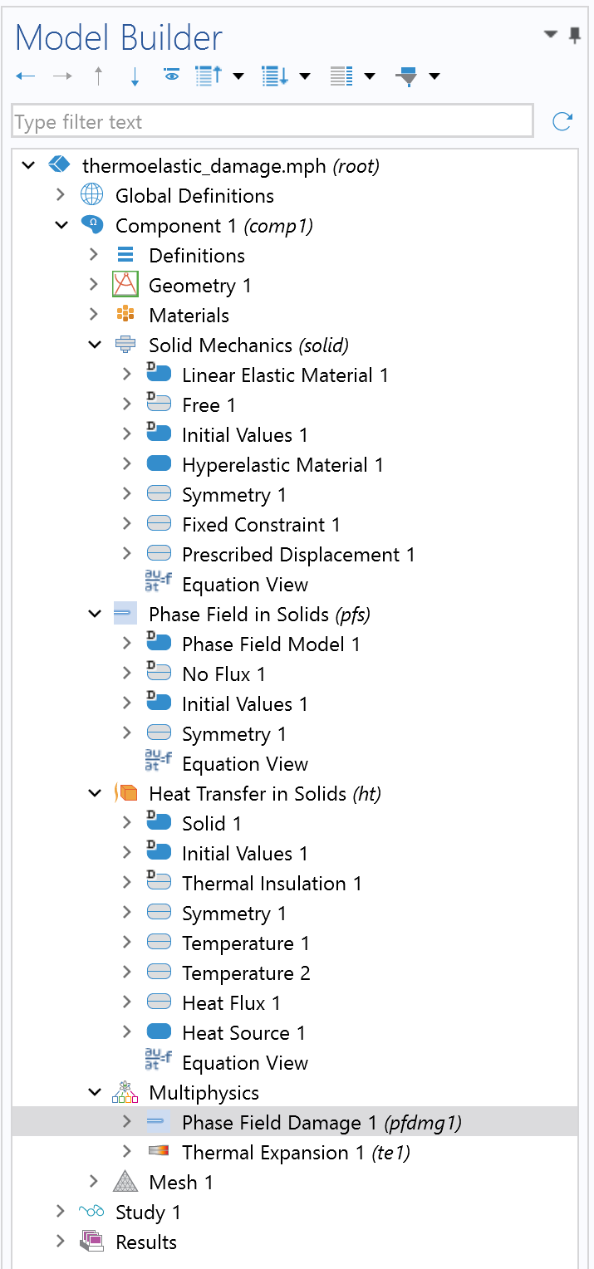
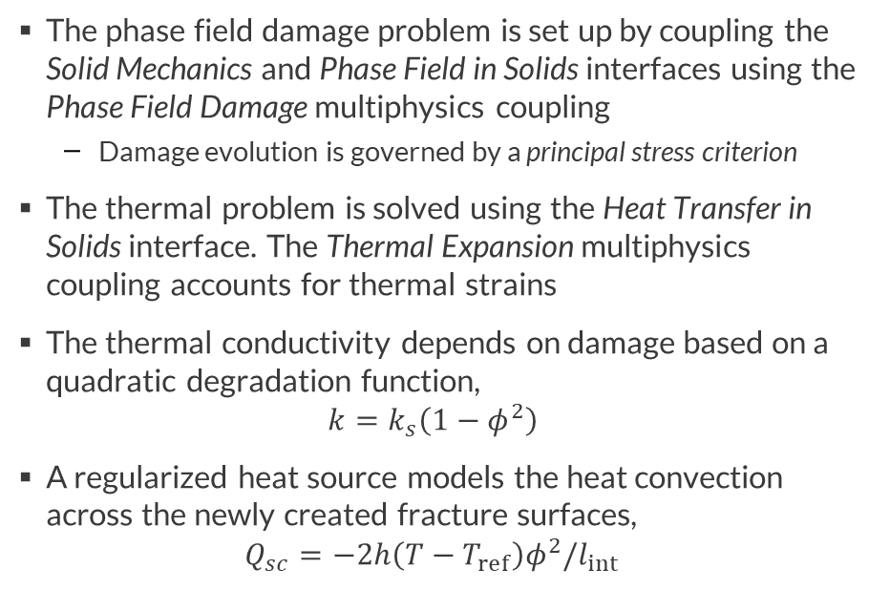
COMSOL Implementation
The phase field damage problem is set up by coupling the Solid Mechanics and Phase Field in Solids interfaces using the Phase Field Damage multiphysics coupling
  Damage evolution is governed by a principal stress criterion
The thermal problem is solved using the Heat Transfer in Solids interface. The Thermal Expansion multiphysics coupling accounts for thermal strains
The thermal conductivity depends on damage based on a quadratic degradation function,
$k=k_{s}\left(1−φ^{2}\right)$
A regularized heat source models the heat convection across the newly created fracture surfaces,
$Q_{sc}=−2h\left(T−T_{ref}\right)φ^{2}/l_{int}$

Slide 5
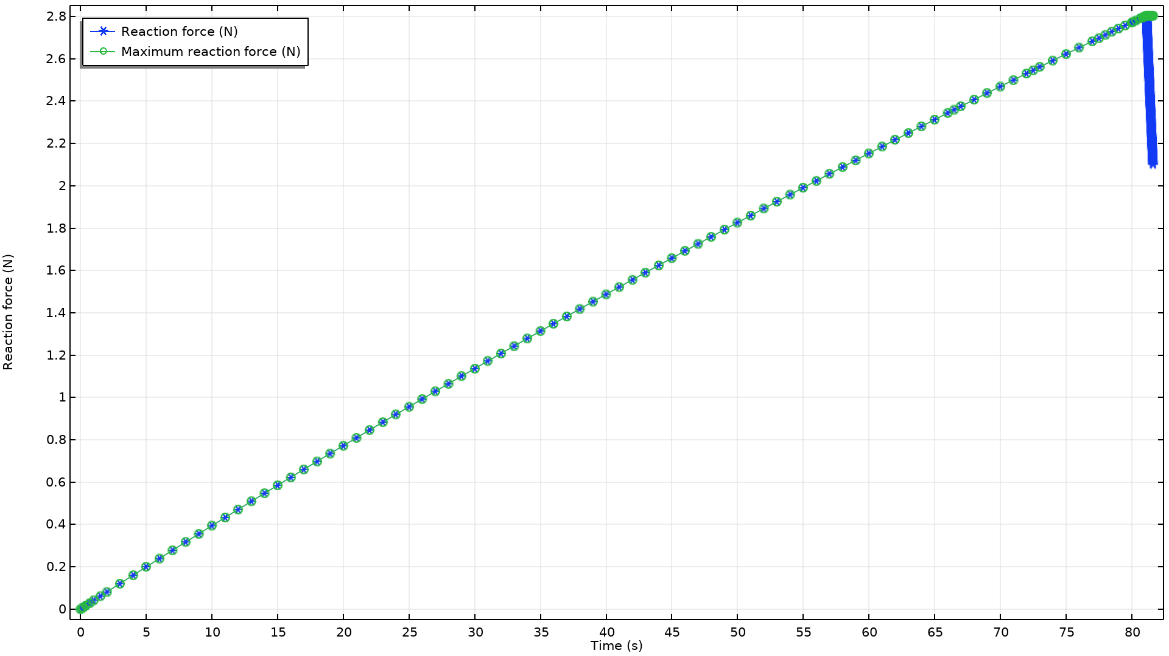
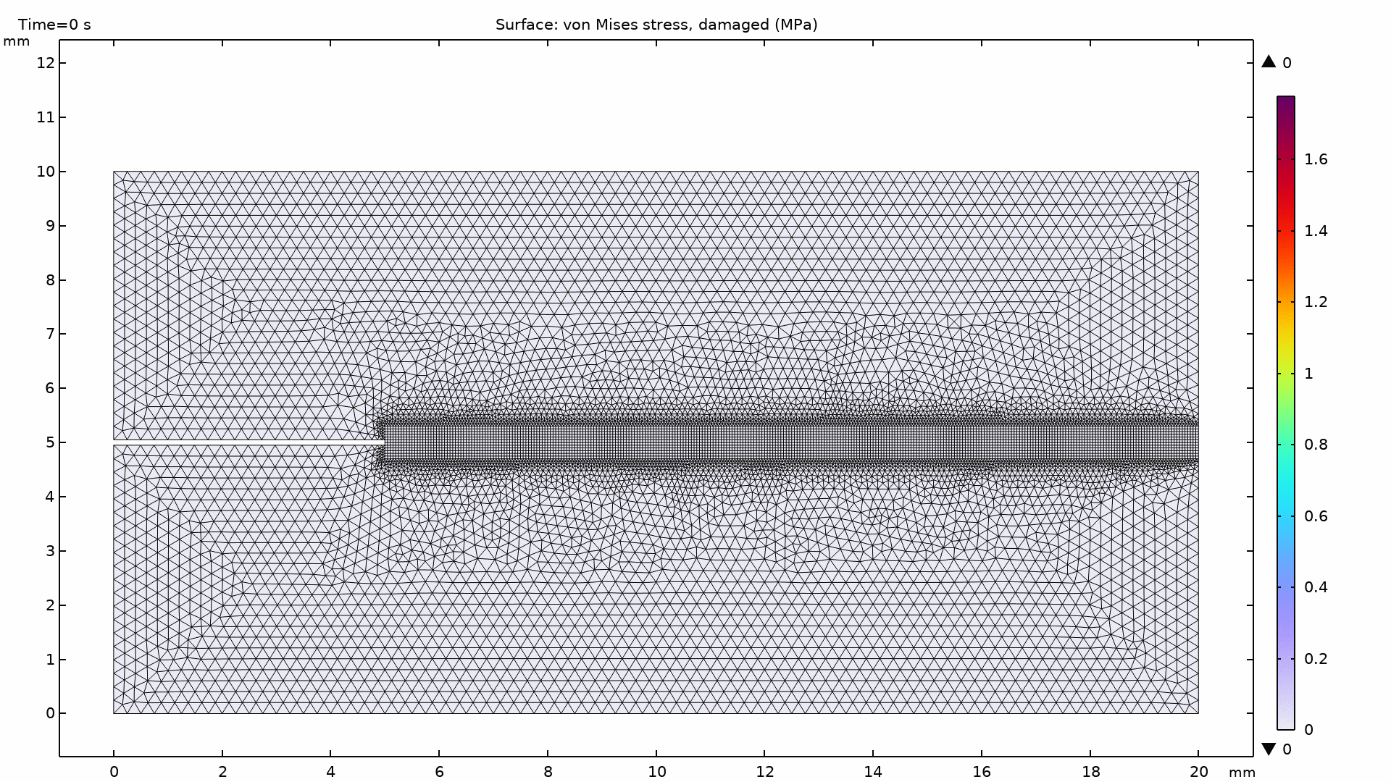
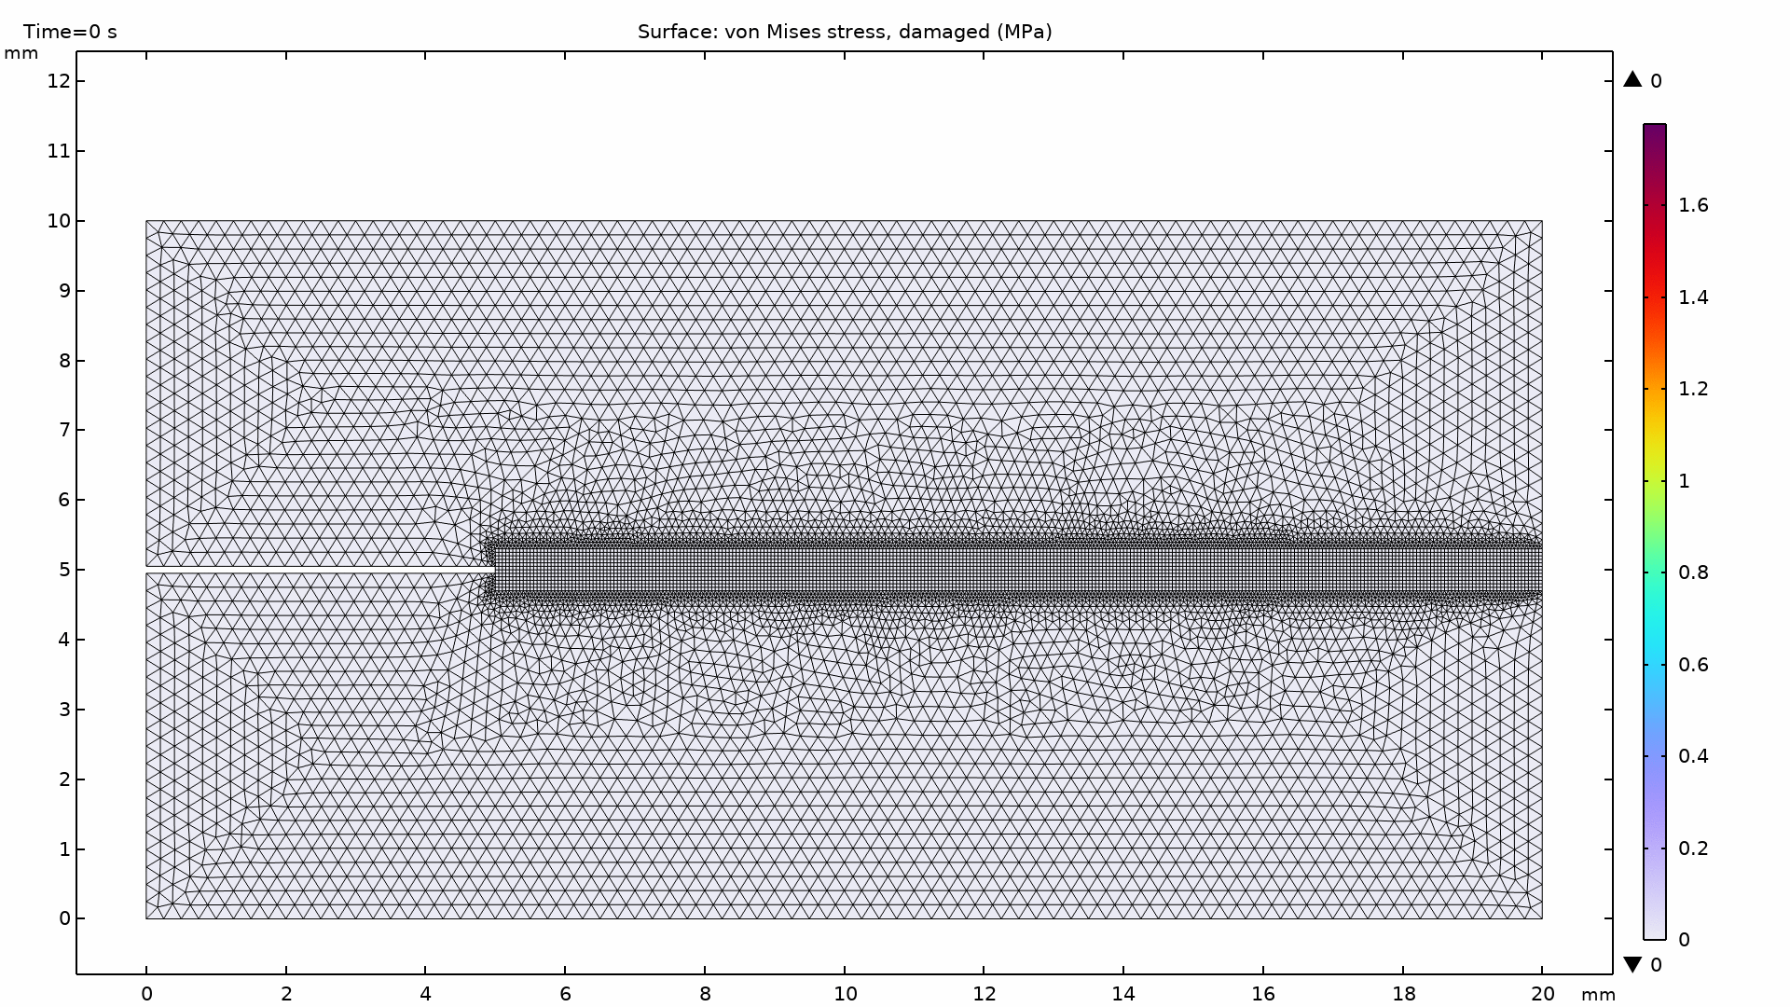
Simulation Results (1/3)
Brittle fracture requires small time steps, here controlled using adaptive time stepping with a tight tolerance
Simulation terminated when the reaction force drops by 25% using a Stop Condition

Slide 6
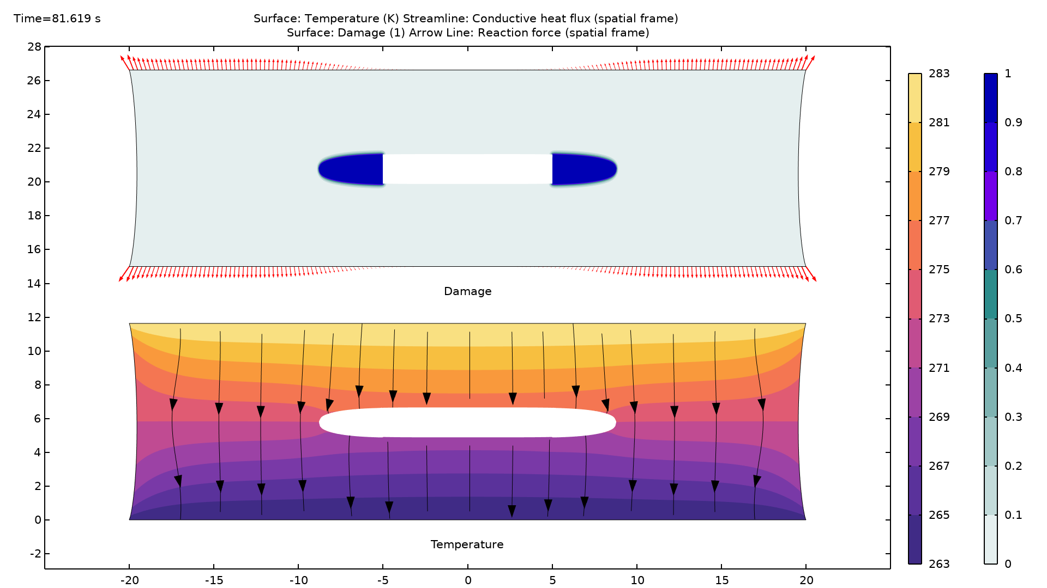
Simulation Results (2/3)
Temperature, conductive heat flux, damage, and nodal reaction forces at the end of simulation
Smooth transition of the temperature and conductive heat flux distribution around the pre-existing and new crack surfaces due to degraded thermal conductivity and apparent heat flux due to convection

Slide 7
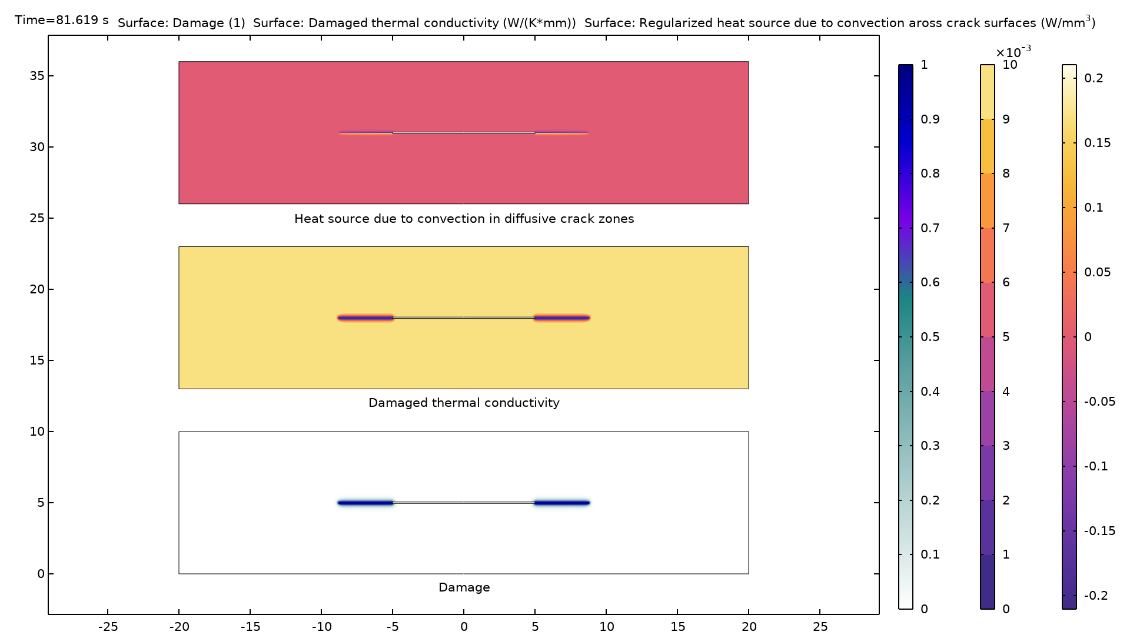
Simulation Results (3/3)
Damage, damaged thermal conductivity, and regularized heat source at the end of simulation, shown in the reference configuration
Damaged regions characterized by
  Reduced thermal conductivity
  Apparent heat source/sink due to convection across new crack faces

