Slide 1
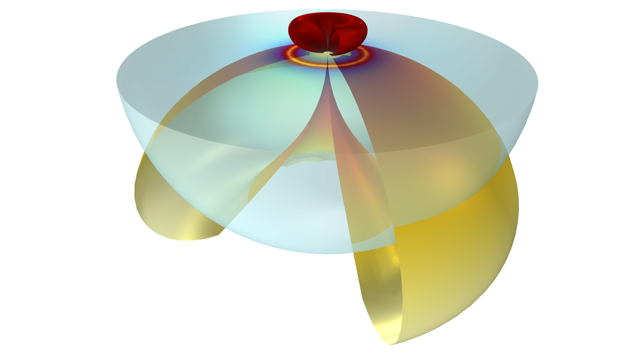
Far-Field Radiation in the
Presence of a Substrate

Slide 2
Introduction and Basic Theory

Slide 3



Introduction
Built-in far-field domain
feature valid for a homogeneous medium
The Far-Field Domain feature in the RF and Wave Optics Modules is based on theory that is only valid for homogeneous environments.
  (Top) An antenna in infinite space is ok because the environment is homogeneous.
  (Bottom) An antenna above water or ground is not ok, because the environment is inhomogeneous.
This is a solely a results evaluation issue.
  The simulation results are correct, but a different theoretical approach to evaluate the far field (FF) is needed.
This document shows how to calculate the FF when the simulation environment varies in the z-direction. Several practical examples are
  A focused laser beam illuminating a gold nanoparticle on a Si substrate.
  Ground penetrating radar where the soil conductivity is a function of depth.
Built-in far-field domain
feature valid for inhomogeneous media

Slide 4
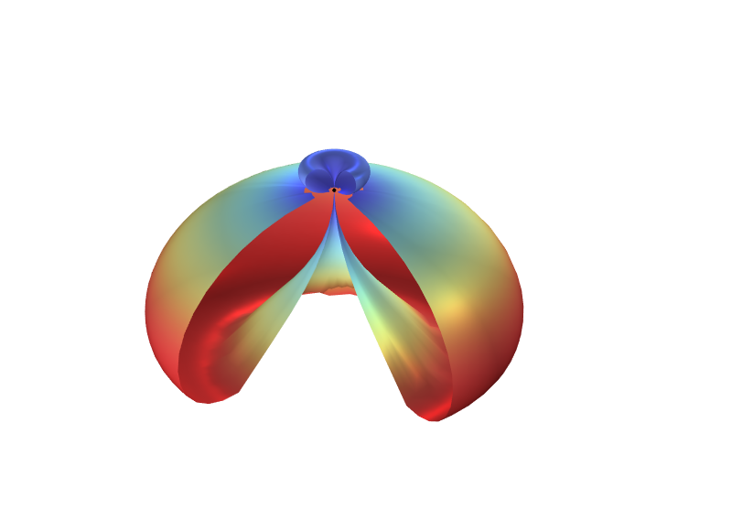
General and Simplified Approaches
We will first present the basic principle used, and then demonstrate a simplified and general implementation.
  Only isotropic materials are considered.
The simplified approach is easier to implement.
  This is only applicable for the common case of two homogeneous domains with their interface at z=0.
  Using this approach you can generate a 3D radiation plot (top right).
The general implementation is more flexible, but also requires more work to implement.
  The FF is calculated at prescribed angles, and so it is not possible to generate a continuous radiation plot.
  The general approach can consider multiple inhomogeneous layers, but the top- and bottom-most domains must be homogeneous.
Familiarity with setting up the underlying radiation simulation is assumed.
For details on the theory refer to Yang, et al. https://doi.org/10.1021/acsphotonics.5b00559
FF pattern
Simplified approach applicable
General approach required

Slide 5
Integrating Fields
When we compute a simulation we obtain what we will refer to as the “local” fields. These are just the computed fields inside of the modeling domain.
The Far-Field Domain feature works by integrating the local fields over a surface that surrounds the source of radiation.
This new approach also integrates over a surface that surrounds the source, except that the integrand is different.
This new integrand has two contributions.
  The local field.
  What we will call an “auxiliary” field discussed on the next slide.
Integration surface

Slide 6
“Auxiliary” Fields
Desired FF in (θ,φ)
Assume we are interested in solving for the FF in a direction (θ,φ). We can calculate the required auxiliary fields in two steps.
1) Remove the source of radiation so that we only consider the background environment.
2) Solve for the fields due to an incident plane wave coming from the direction (θ,φ).
  If the environment is homogeneous, this would simply be a plane wave.
  When the environment is stratified, this includes reflection/transmission at the material interfaces.
  The polarization of the plane wave must be aligned with the desired polarization of the FF.
The simplified approach uses an analytic equation for the auxiliary fields.
For the general case, we solve for the auxiliary fields in COMSOL using a 1D wave equation.
  Two Coefficient Form Edge PDE interfaces are used for E_{θ} and E_{φ}.
  One simulation is required per FF angle.
2) Solve for fields due to plane wave from (θ,φ)
1) Remove emitter

Slide 7
Simplified Approach
Two Homogeneous Domains

Slide 8
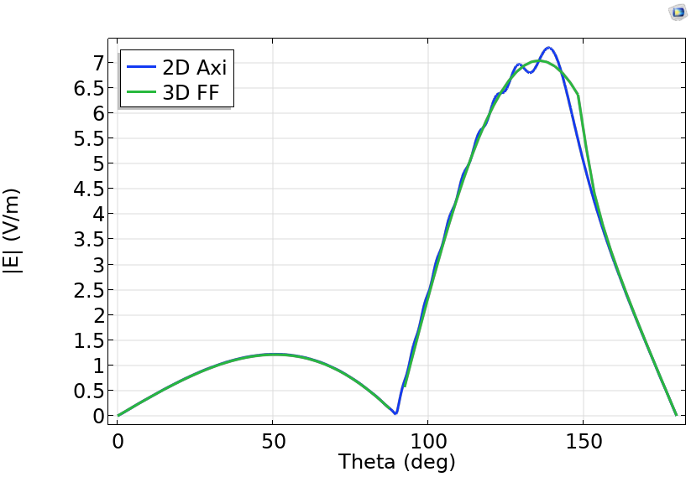
INTRODUCTION
Simplified Approach
The file Simplified_FF_Comparison.mph demonstrates the simplified approach using two homogeneous domains.
  The model is cylindrically symmetric to compare the 3D FF results with a large 2D axisymmetric simulation.
  A circular current loop radiates at the interface of air and a dielectric substrate of ε_{r}= 4.
The model has features for comparing either a magnetic or electric current source.
  Enable the appropriate 3D excitation.
  Set the 2D axisymmetric model to out-of-plane vector for an electric current or in-plane vector for a magnetic current.
  The electric current will solve for Ephi with Etheta = 0.
  The magnetic current will solve for Etheta with Ephi = 0.
On right is a comparison of |Ephi| at a distance of 10 λ₀.
  The ripples in the 2D axisymmetric plot are because the evaluation is not sufficiently into the far-field.
  These decrease with increasing radius, at the expense of increased computational cost.
The E-field pattern is shown in the top image, where ¼ of the pattern is removed for clarity.
Norm of electric field

Slide 9
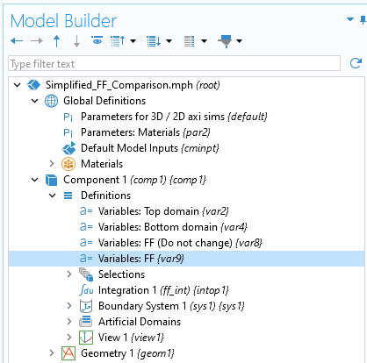
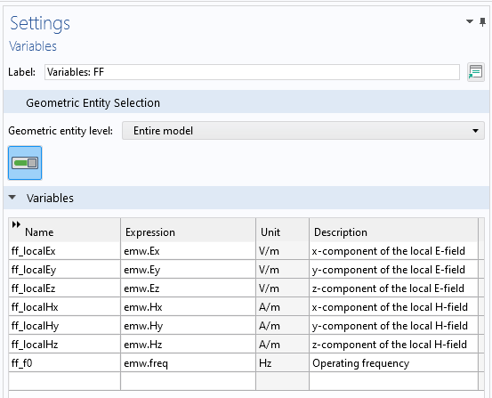
IMPLEMENTATION DETAILS
Simplified Approach
An integration operator (ff_int) has been added to integrate over a surface that surrounds the radiation source.
There are four Variables nodes. Two are defined globally, and the remaining two are defined for the top and bottom domains.
  Ensure ff_epsr and ff_mur match the material properties definitions for their respective domains.
The Variables: FF node may need to be modified slightly for your own implementation.
  If you are using the Wave Optics Module, “emw” will need to be replaced with “ewfd”.
  If using the scattered field formulation, “emw.Ex” should be “emw.relEx” to use the relative field, and similar for the other E and H variables.
Use the provided text files to import these into your own model.

Slide 10
General Approach
Introduction and Walkthrough

Slide 11
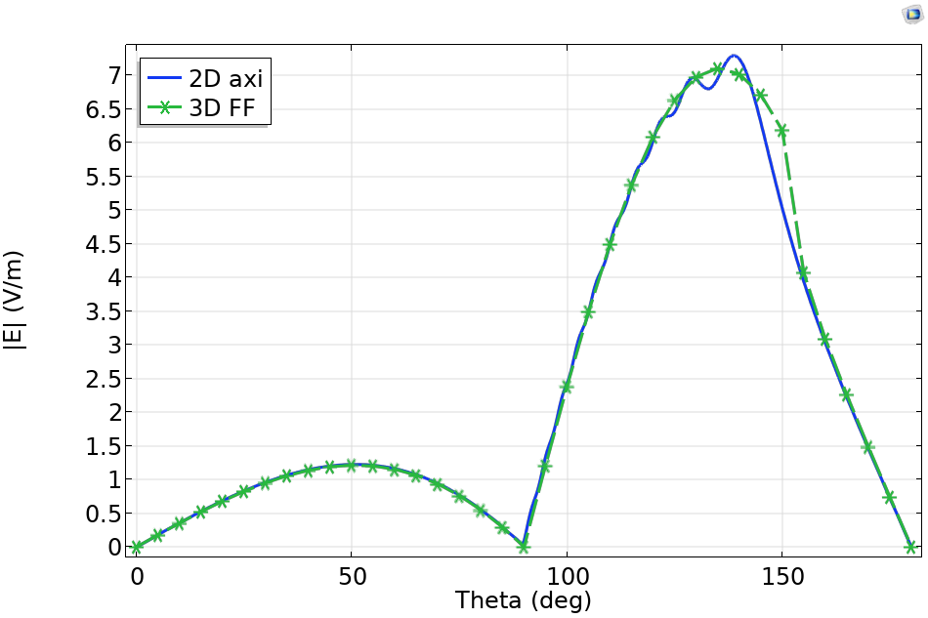
INTRODUCTION
General Approach
The file General_FF.mph demonstrates the generalized implementation.
Unlike the simplified version, the general version only calculates the FF at specific angles.
  The 3D FF plot on right has asterisks at the calculated angles, and the connecting line is interpolated.
  Because the FF solutions are discrete, it is not possible to generate a 3D radiation plot.

Slide 12
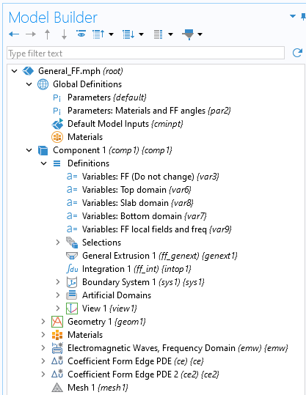
IMPLEMENTATION DIFFERENCES
General Approach
The parameter and variable lists are slightly different.
  The variables for the FF angle (ff_theta, ff_phi) are now parameters so they can be swept over.
  Each layered domains needs its own variable definition.
Two Coefficient Form Edge PDE interfaces calculate the auxiliary fields.
A General Extrusion operator maps the auxiliary fields to the integration surface.
To add to your own models
  Use the provided text files for variables and parameters, as with the simplified case.
  Use Insert geometry and physics from the FF_Helper.mph file as shown on the next slide.

Slide 13
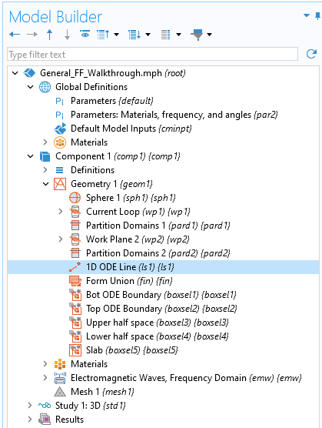
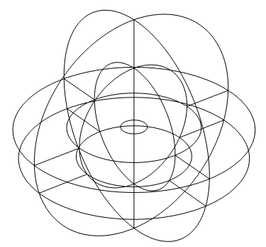
WALKTHROUGH
Geometry
Open provided file, which is a working simulation of a current loop.
  General_FF_Walkthrough.mph
  The parameters are already imported, as they are used in the working model.
Right click Component 1 > Geometry 1 and select Insert Sequence.
  Select General_FF_Helper.mph
This adds in a Line called 1D ODE Line and a number of selections.
Select 1D ODE Line. For the starting point and endpoint, select the top and bottom points in the sphere as shown on right.
We recommend updating the selections for the half spaces and slab, but this is not required.
Start point
Endpoint

Slide 14
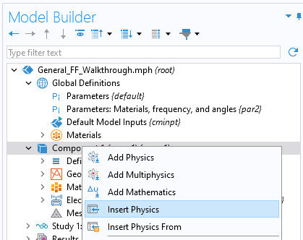
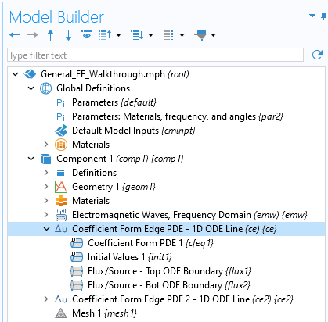
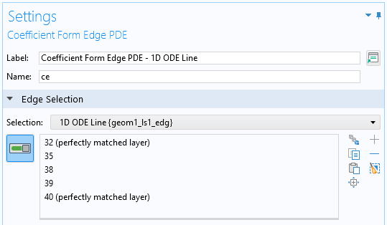
WALKTHROUGH
Physics
Right click Component 1 and select Insert Physics.
  Select General_FF_Helper.mph again.
  Select the two Coefficient Form Edge PDEs and click Ok. This will add those two interfaces to the model.
Select the first Coefficient Form Edge PDE interface.
  Change the selection to 1D ODE Line.
  Select the first Flux/Source boundary condition under the interface. Change the selection to Top ODE Boundary.
  Select the second Flux/Source boundary condition. Change the selection to Bot ODE Boundary.
Do the same for the other Coefficient Form Edge PDE interface and boundary conditions.

Slide 15
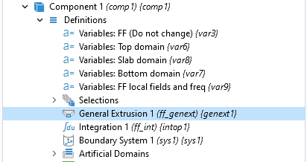
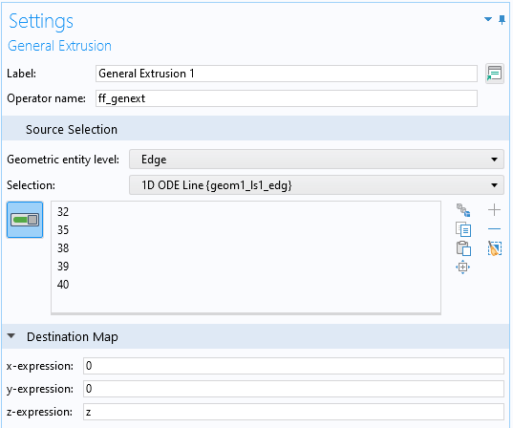
WALKTHROUGH
General Extrusion and Variables
Right click Component 1 > Definitions and select Nonlocal Couplings > General Extrusion.
  Change the name to ff_genext, the geometric entity level to edge, and the selection to 1D ODE Line.
  For the destination map, set the x and y expressions to 0. Leave the z-expression as z.
Add five Variables node to the model by right clicking Component 1 > Definitions and selecting Variables.
  For the slab use General_FF_VariablesSlabDomain_Demo.txt instead of the _Inhom file, which is more general.
Import from the provided text files. Two of the variables (FF) will be global, and the other three are for the slab plus top and bottom half spaces.

Slide 16
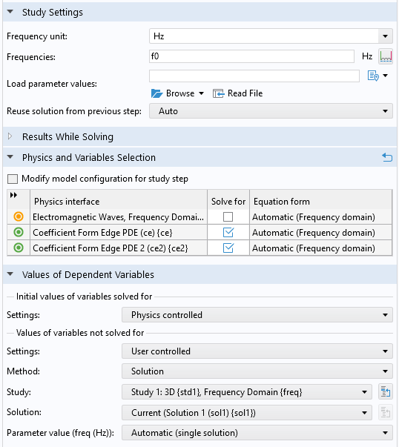
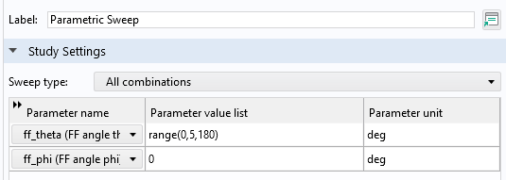
WALKTHROUGH
Compute
Select Study 1 > Step 1: Frequency Domain.
  Remove the Solve for checkmarks for the Coefficient Form Edge PDE interfaces.
Compute Study 1.
Add an empty study to the simulation.
  Select this new study and deselect the Generate default plots checkbox.
Right click the new study and select Study Steps > Frequency Domain > Frequency Domain
  Update settings to match top right figure.
Add a Parameter Sweep to this study as shown.
  These are the specific FF angles to solve for.
Compute Study 2.

Slide 17
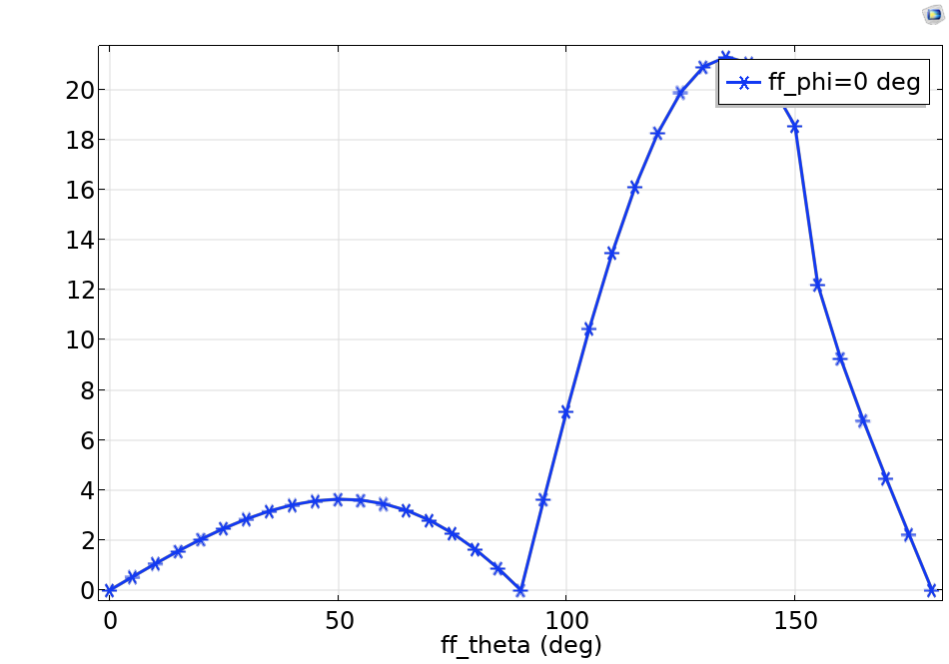
WALKTHROUGH
Results
Right click Results and select 1D Plot Group
  Change the Dataset to Study 2.
Right click Results > 1D Plot Group and select Global.
  For the Expression enter abs(ff_Efarphi)
  Under x-Axis Data change the Axis source data to ff_theta
  Under Coloring and Style change the Marker to Asterisk to see the precise points.
Plot
The file General_FF.mph is the final version of this walkthrough.

Slide 18
General Approach
Multiple Layers and Inhomogeneous Layers

Slide 19
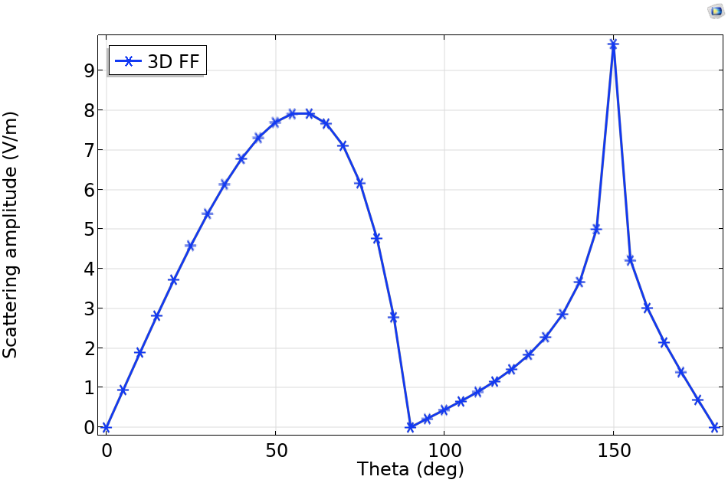
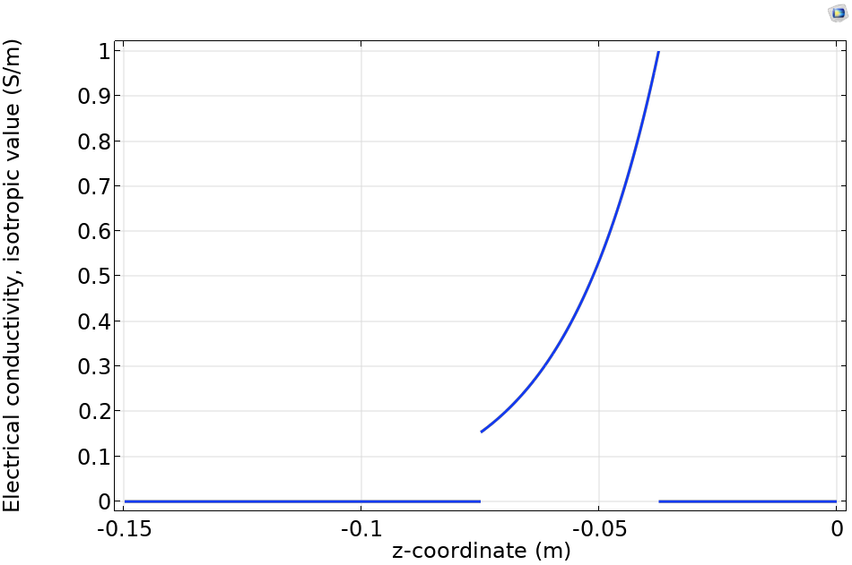
GENERAL APPROACH
Multiple Inhomogeneous Layers
The file General_FF_MultInhomLayers.mph shows how multiple layers and inhomogeneous layers can be included.
The first layer (Slab 1) is homogeneous, and the second layer (Slab 2) has a conductivity that depends on z.
  One Variable definition is required for each layer.
If a layer is inhomogeneous, the material property definitions need to be defined in the Variable definition for that layer.
  See conductivity in Slab 2 (bottom right).
  These variables are in the file General_FF_VariablesSlabDomain_Inhom.txt
  This will require manually meshing, as the physics-controlled mesh only handles homogeneous domains.

