Slide 1
Magnetic Damping of Vibrating Conducting Solids
COMSOL

Slide 2
Introduction
When a conductive solid material moves through a static magnetic field, an eddy current density is induced
That induced eddy current density interacts with the static magnetic field and the result is a Lorentz force back on the solid that counteracts the motion
Therefore, a conducting solid that is vibrating in a static magnetic field experiences a structural damping

Slide 3
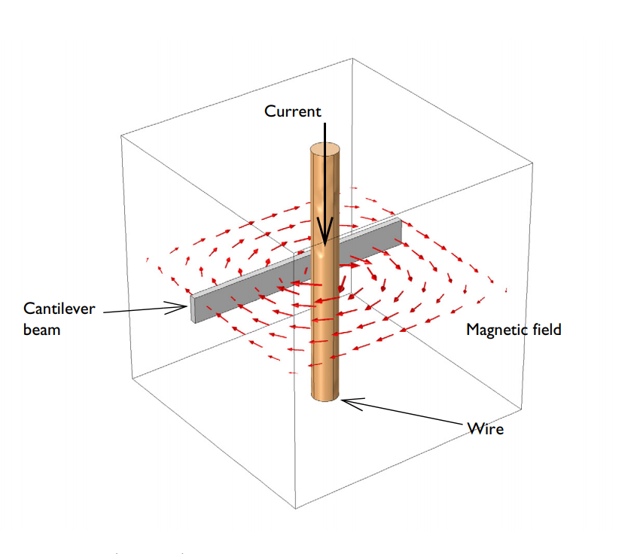
Model Definition
This example computes the damping effect when a cantilever beam is harmonically excited across a range of frequencies and placed in a strong magnetic field
Assumptions made:
  the relative magnitude of the structural displacements are small
  the material has isotropic and linear properties
  the damping Lorentz force can be computed from the static magnetic field and the motion-induced AC eddy current density
A vibrating beam next to a current carrying wire experiences magnetic damping

Slide 4
Model Definition
Second-order effects arising from the AC magnetic field generated by the eddy currents are not included in the computation
The AC magnetic field is also computed and found to be 2-3 orders of magnitude smaller than the DC magnetic field
A vibrating beam next to a current carrying wire experiences magnetic damping

Slide 5
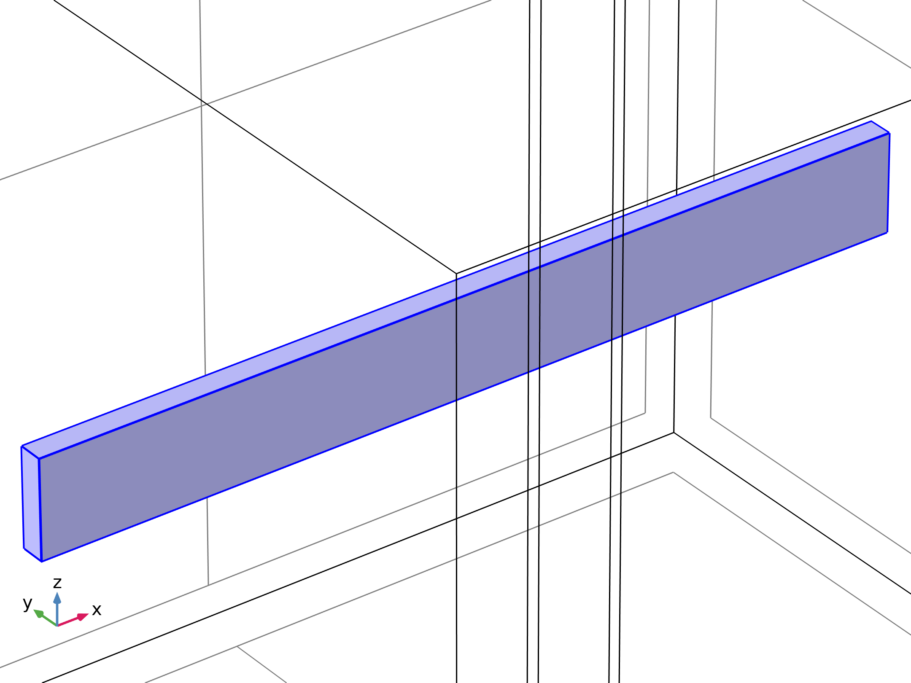

Model Definition
Solid Mechanics

Slide 6
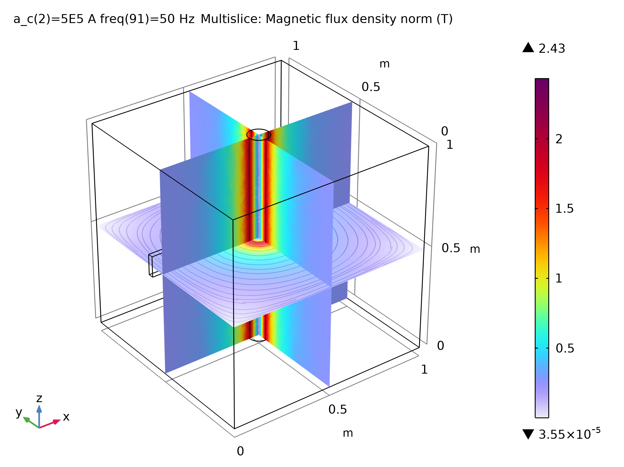
Results
The figure shows the magnetic flux density computed for the structure
The magnetic field around a current carrying wire

Slide 7
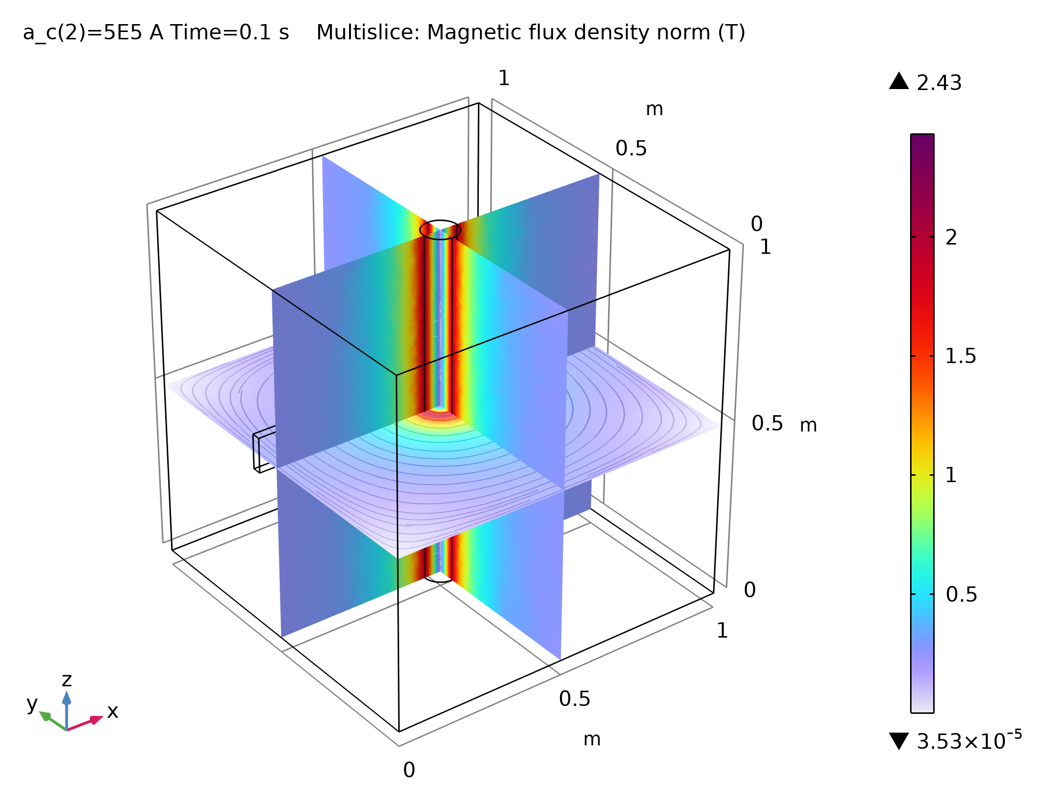
Results
The figure displays the magnitude of the displacement of the tip of the beam versus excitation frequency for two different magnetic field intensities for the frequency-domain structural dynamics problem
Displacement of the tip of the beam versus excitation frequency for differing magnetic field strengths

Slide 8
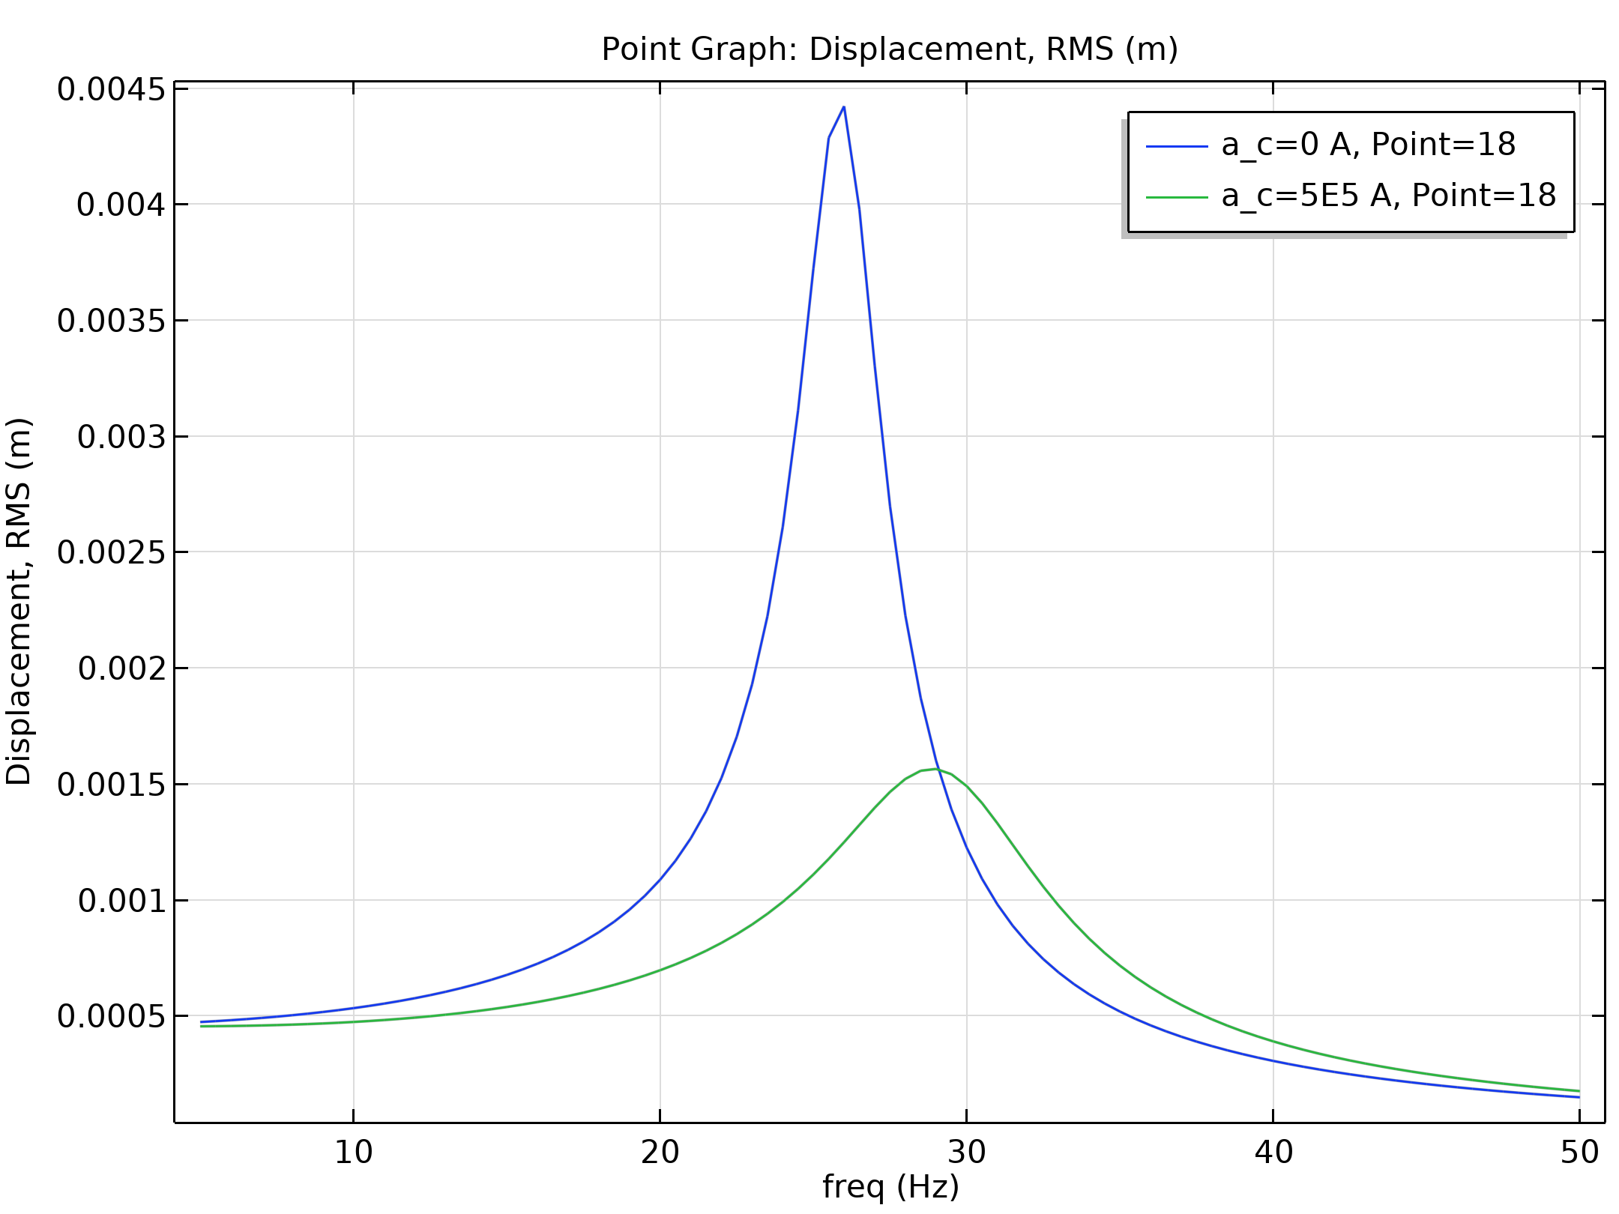
Results
The figure shows a snapshot of the induced eddy current distribution in the beam
The AC current distribution

