Slide 1
Ceramic Water Filter with Activated Carbon Core
COMSOL

Slide 2
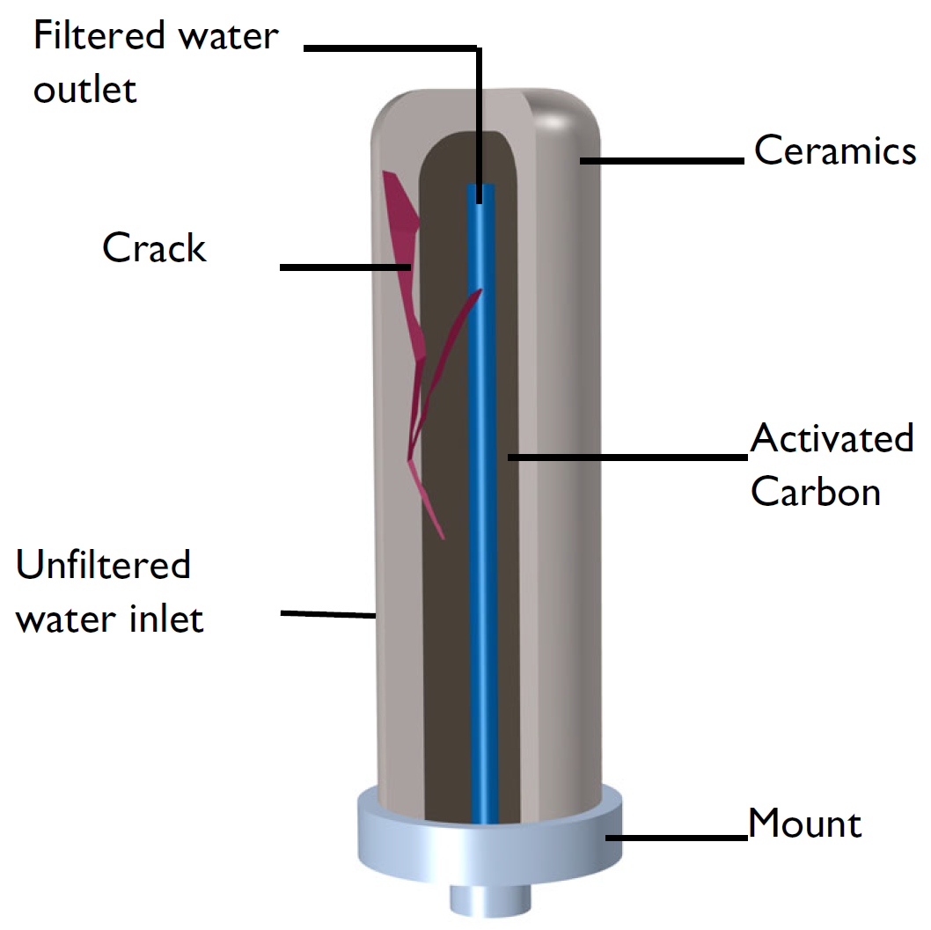
Introduction
Drinking water can contain various impuritiers like dirt particles, bacteria, chlorine, or trihalomethanes.
This example illustrates how to model the tranport of chlorine and the trihalomethane chloroform through a ceramic water filter candle with an activated carbon core.
Such filters are found in tabletop gravity filters or as part of a larger reverse osmosis filter system.
The model shows how to set up the flow and transport equations and examines the effect of a small fracture in the ceramics part.
Sketch of the ceramic water filter with crack.

Slide 3
Introduction
All substances that are filtered out because of their size are referred to as "particles".
Sketch of the ceramic water filter with crack.

Slide 4
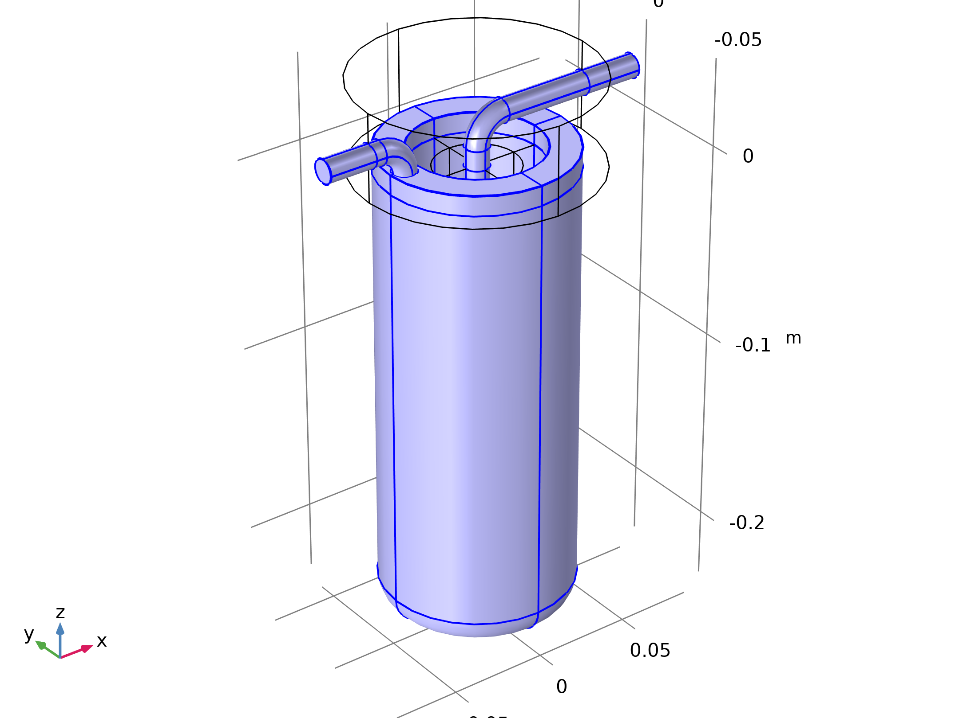


Model Equations - Porous Media Flow
Darcy's Law
Laminar Flow

Slide 5
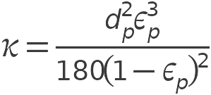
Model Equations - Porous Media Flow
The Kozeny-Carman relationship for permeability is used in the activated carbon region
d_{p} is the mean granular carbon diameter and ε_{p} the porosity
Laminar Flow

Slide 6
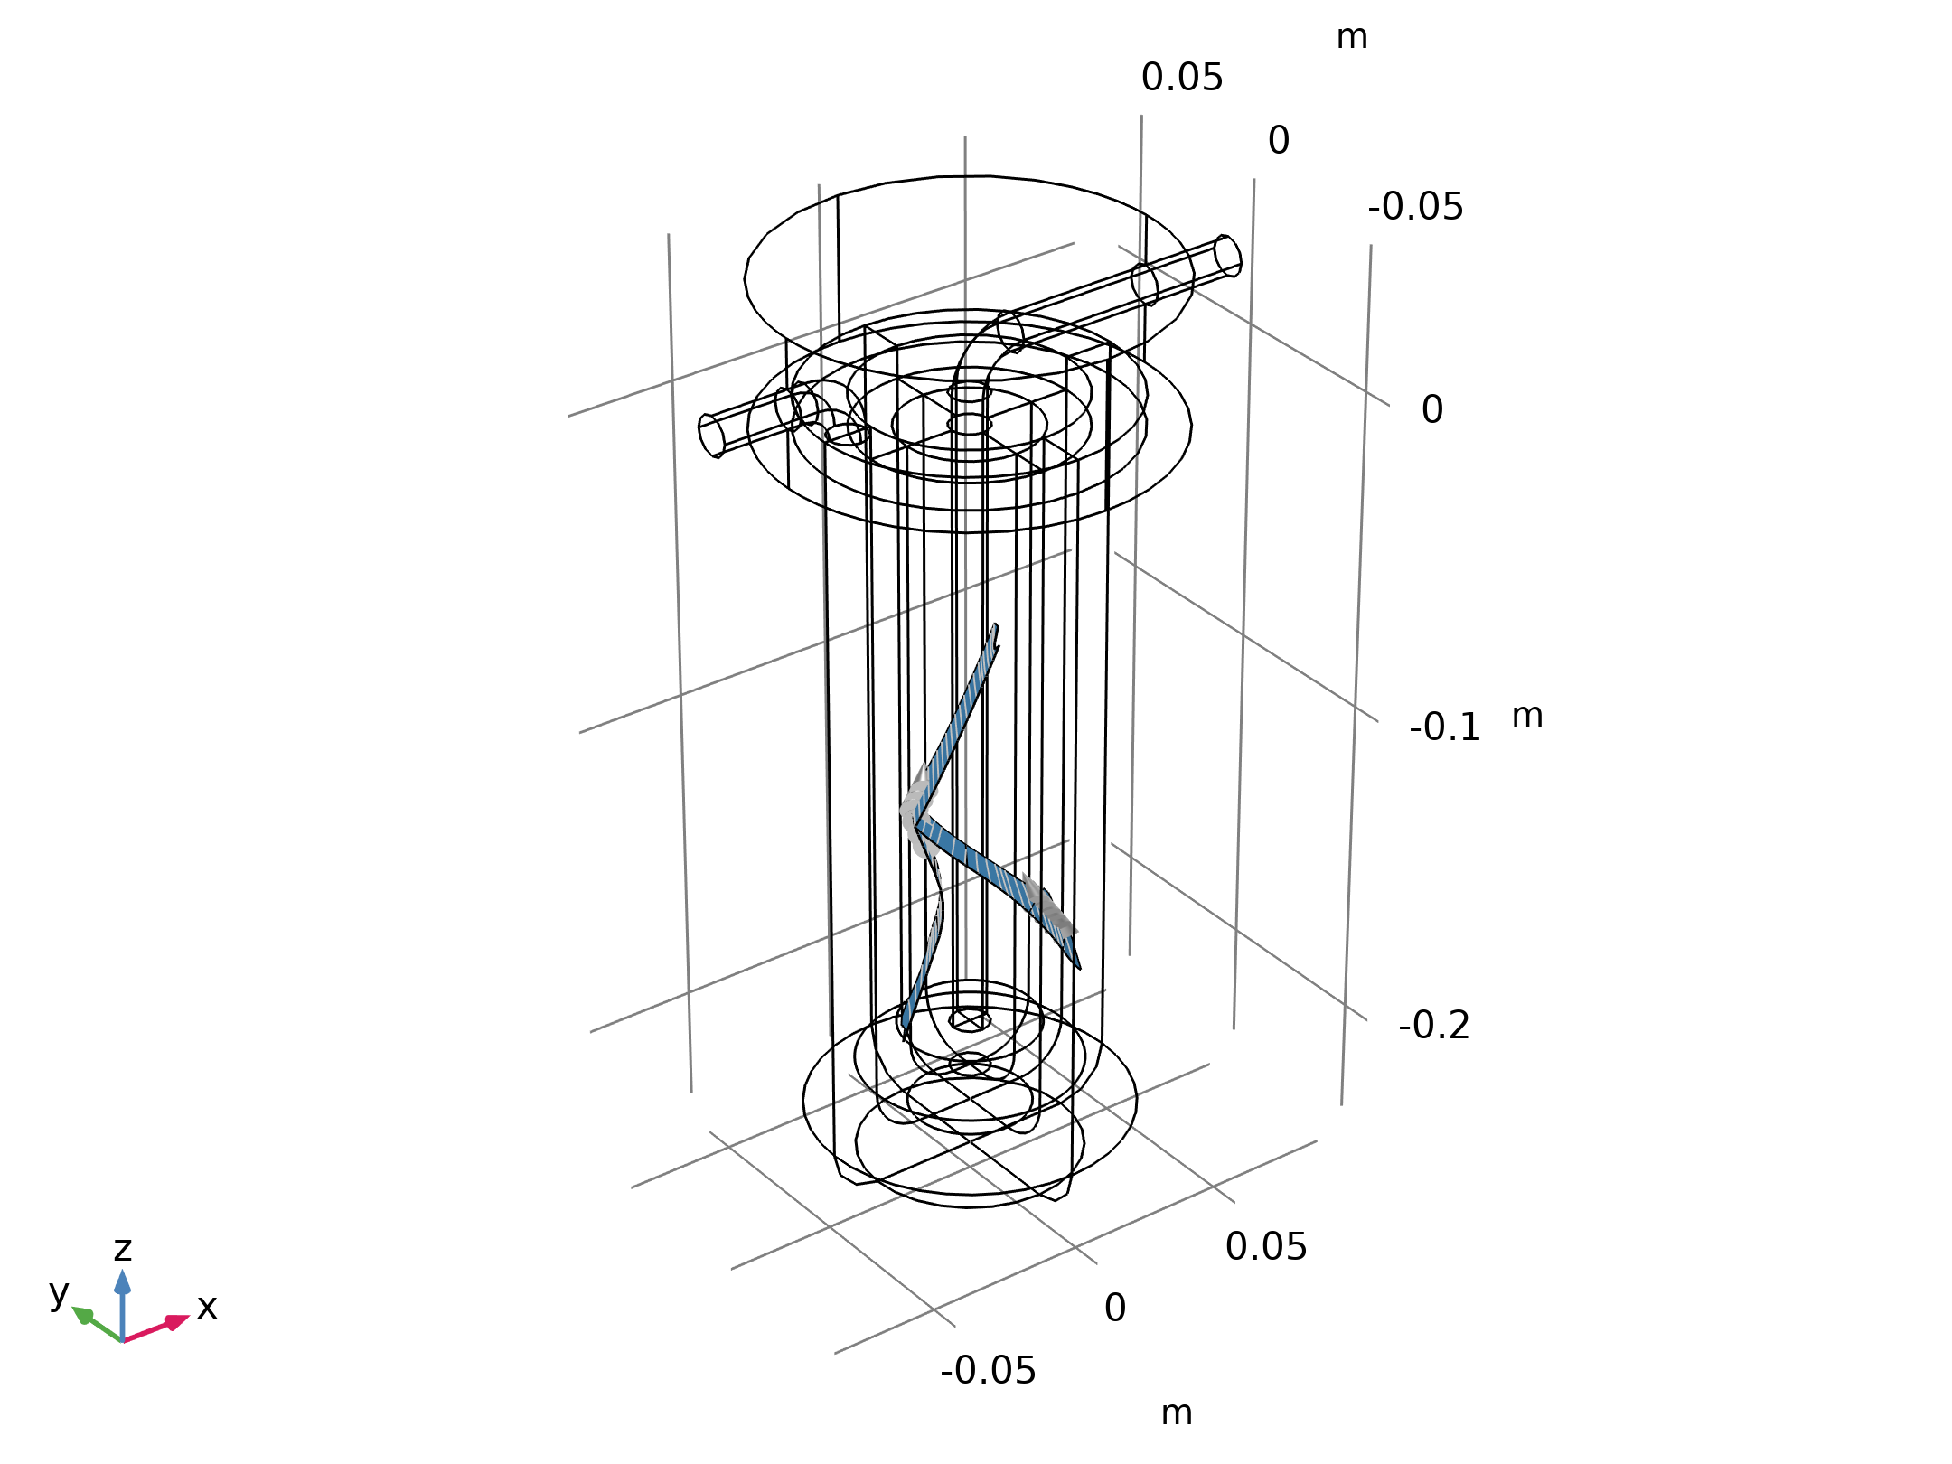
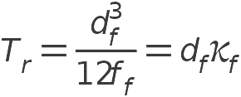
Model Equations - Porous Media Flow
The crack is modeled using the Fracture feature of the Darcy's Law interface
The permeability is calculated using a cubic law which relates the transmissivity of the fracture to its aperture d_{f} with f_{f} beeing the roughness factor.
Fracture

Slide 7
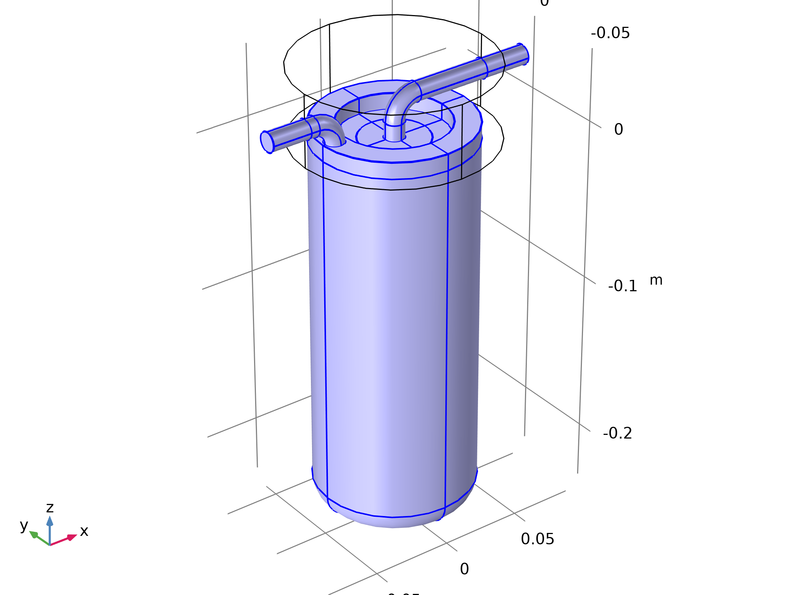


Model Equations - Contaminant Transport
Transport of Diluted Species in Porous Media
The Transport of Diluted Species interface is used
The Chloroform is removed by adsorption
The removal of particles due to their size is modeled using a sink term
Transport of Diluted Species

Slide 8
Model Equations - Contaminant Transport
The Chlorine removal is modeled using a reaction rate
Exact values strongly depend on the properties of the filter material and are usually determined experimentally
Transport of Diluted Species

Slide 9
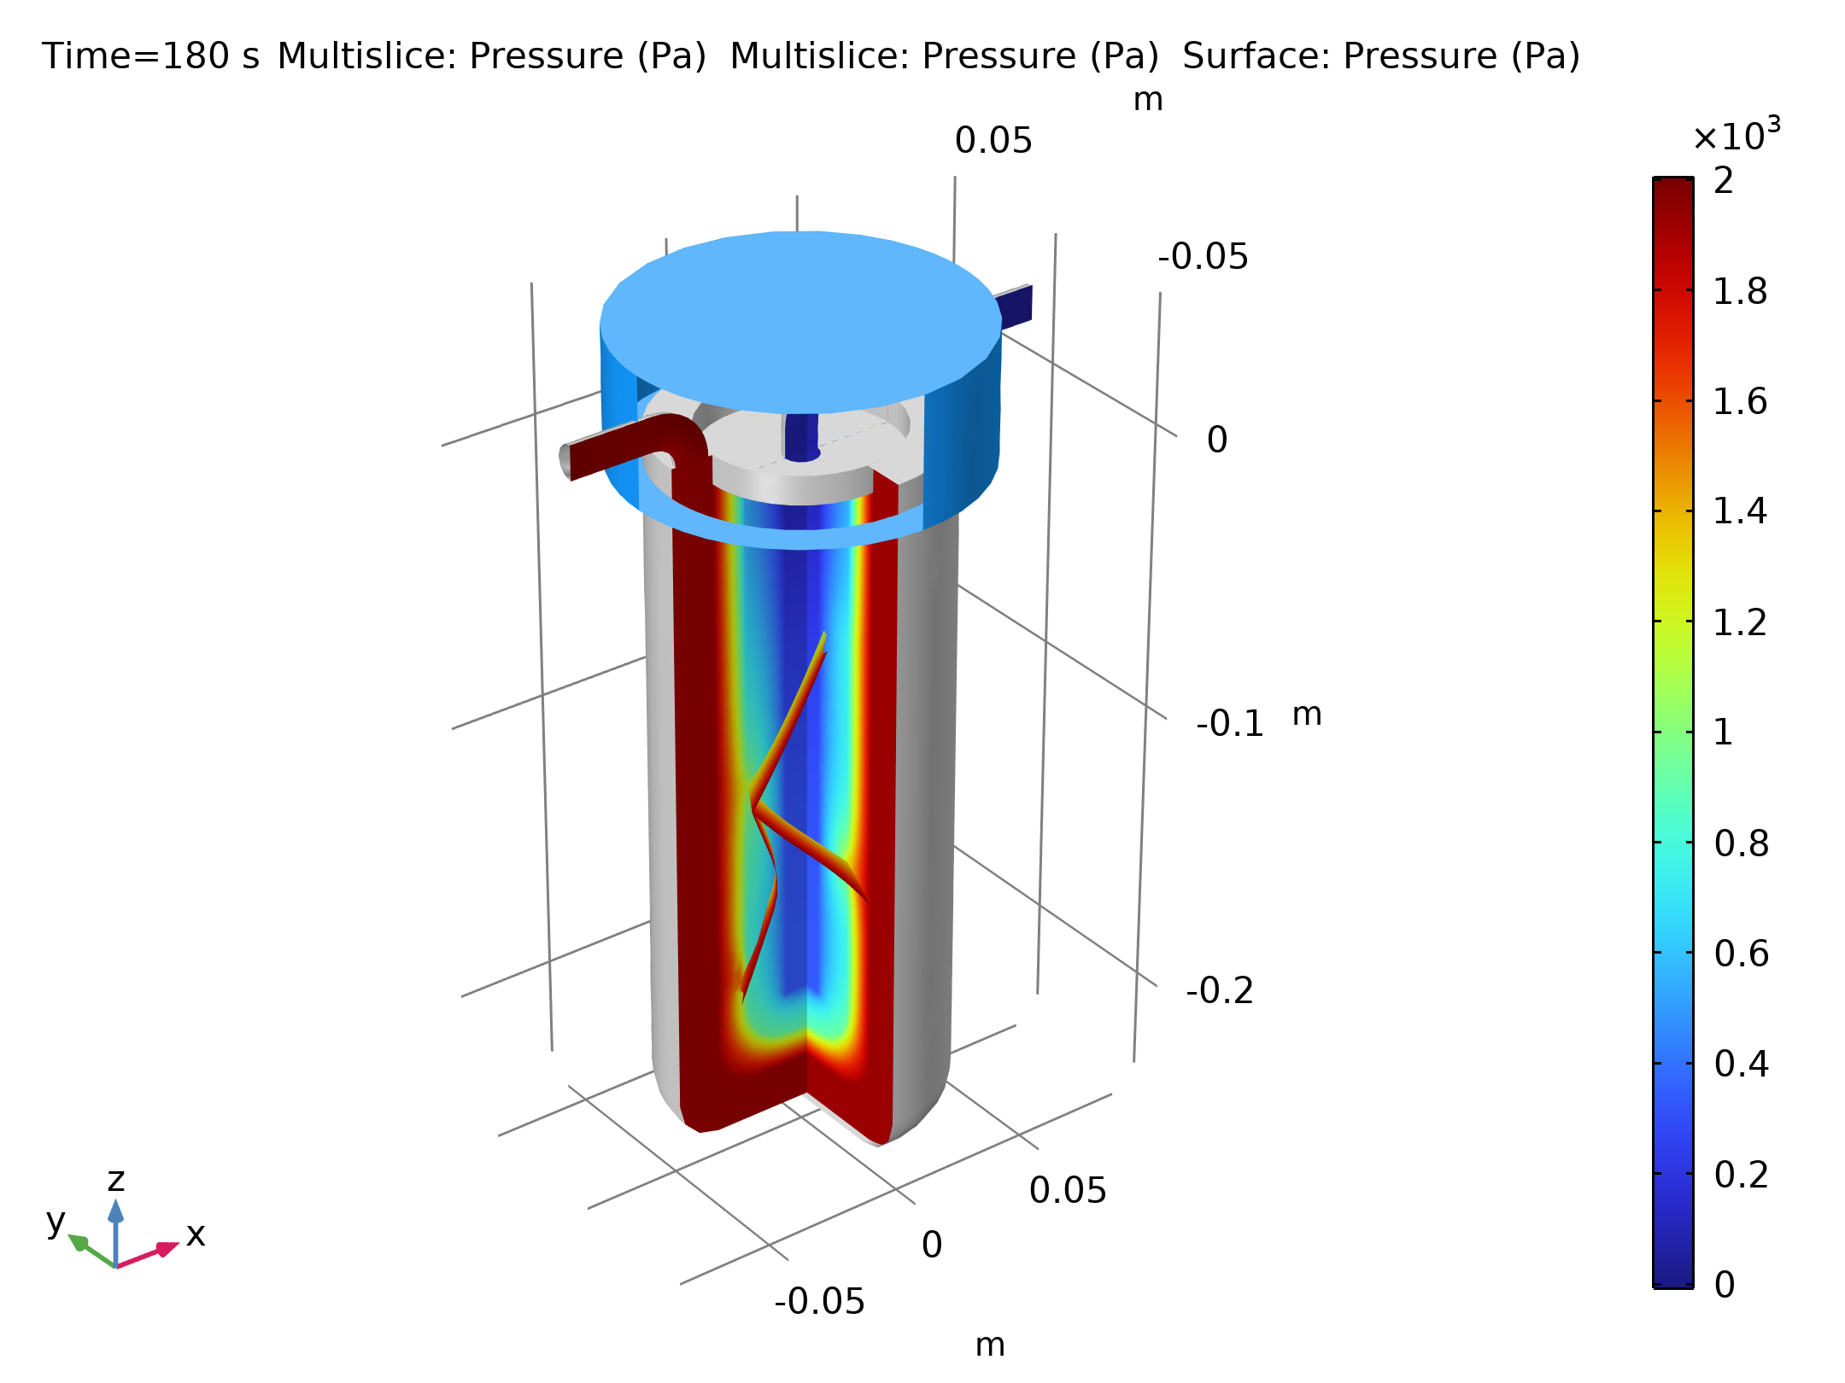
Results
The flow field is assumed to be stationary and independent of the concentrations.
Results are used as input to calculate the time-dependent transport equations.
Pressure (slices) and velocity field (arrows) after 120s of simulated time.

Slide 10
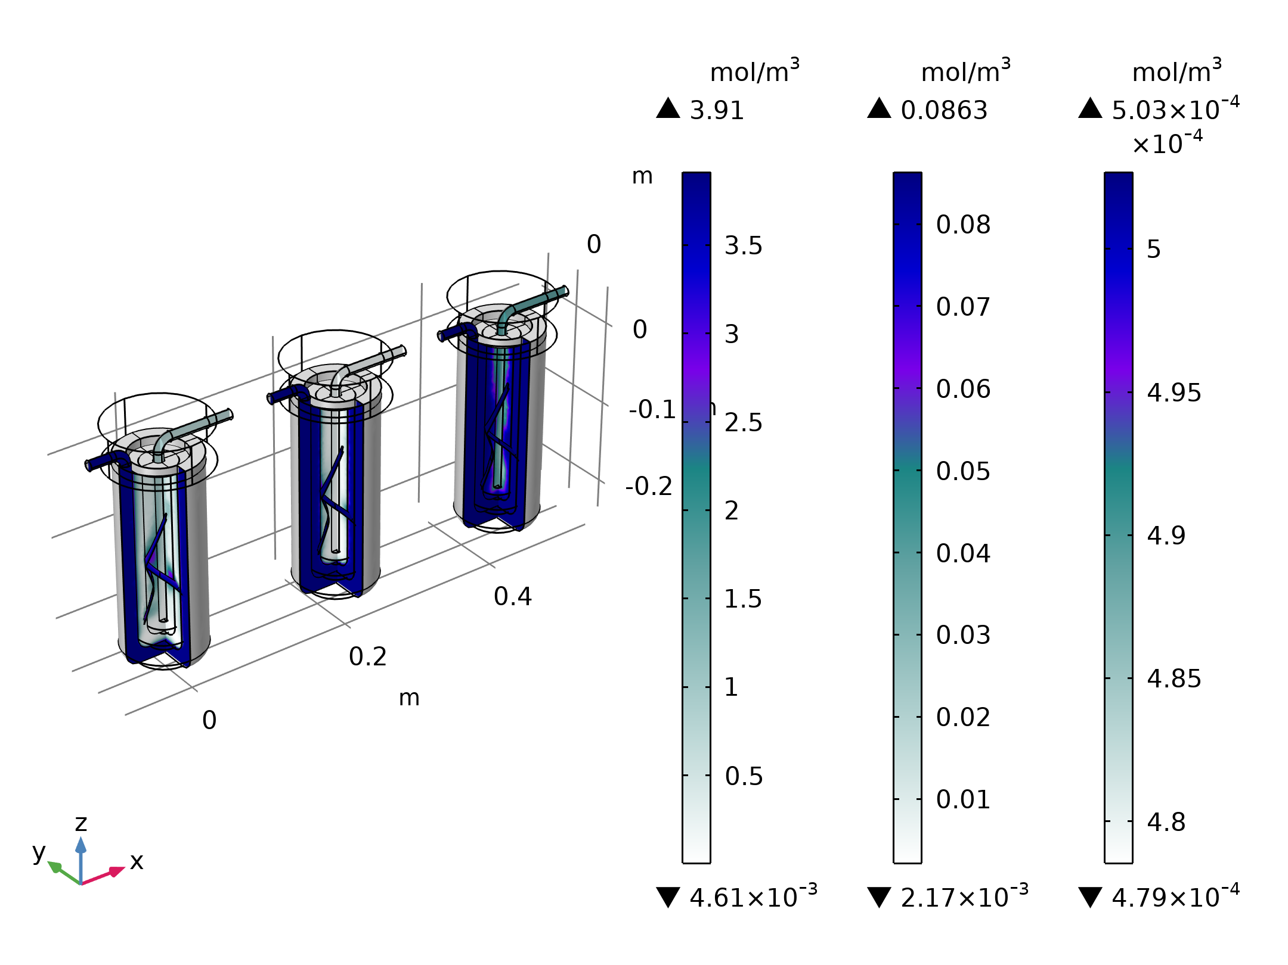
Results
Concentrations of particles (left), Chlorine (middle), and Chloroform (right) in mol/m^3.

Slide 11
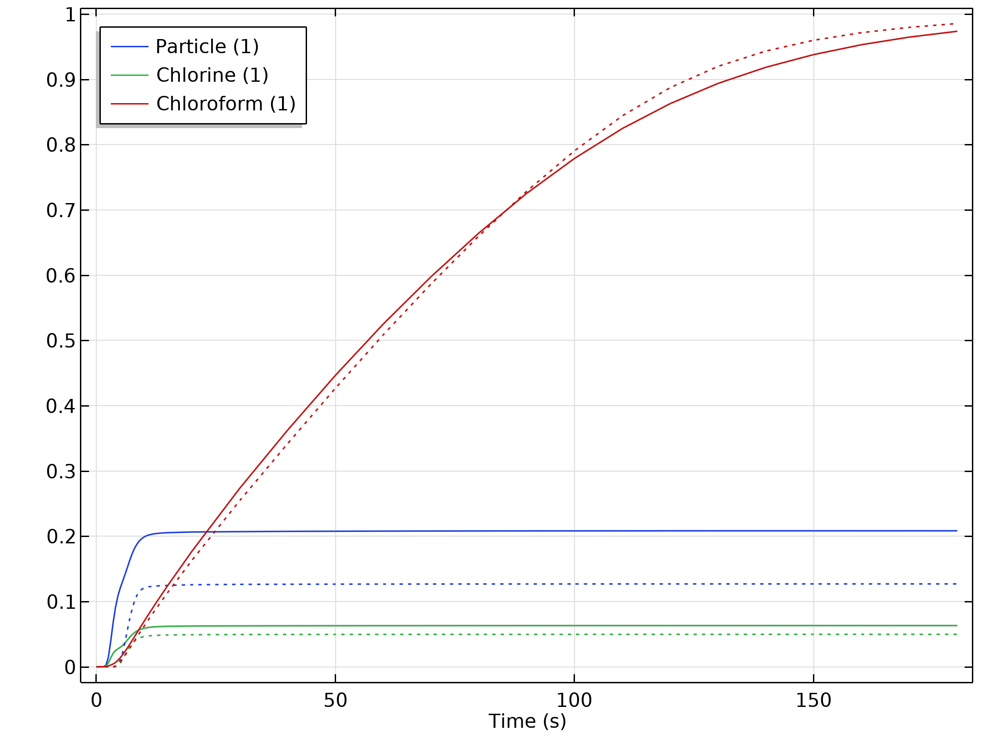
Results
Particles are filtered out at the surface, except where the fracture allows the particles to pass the filter.
The amount of chlorine is reduced significantly by the reaction with activated carbon.
Chloroform can not be reduced by this filter. Therefore, trihalomethanes are already filtered in the waterworks, with a very strict upper limit (often 0).
Ratio of the concentrations at the outlet to the inlet concentrations.

