Slide 1
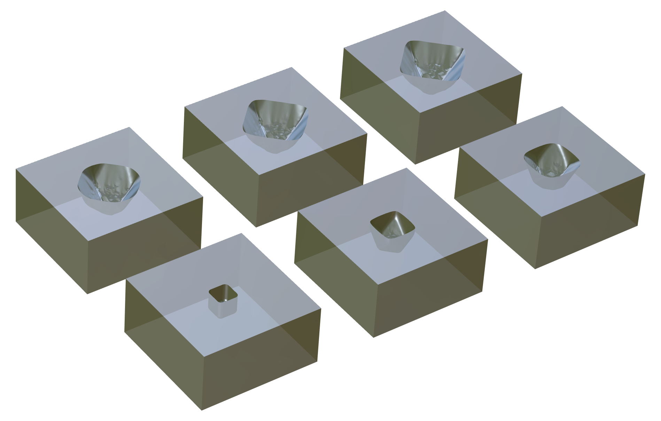
Anisotropic Wet Etching of Silicon in a KOH Solution
COMSOL

Slide 2
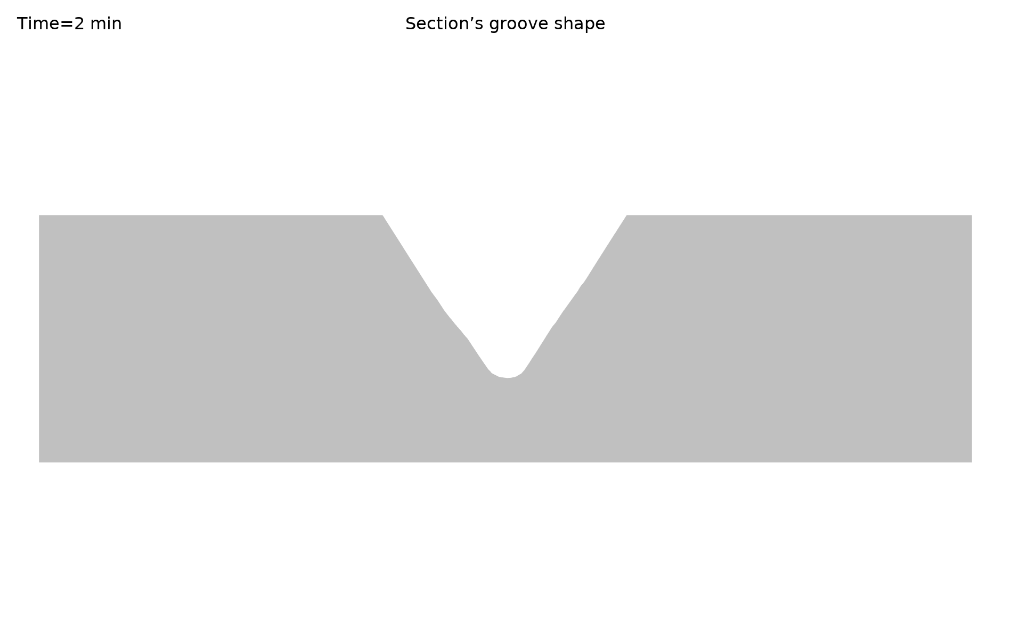
Model Setup
Based on the different etching rates of silicon's crystal planes in the KOH solution, the anisotropic wet etching of silicon is simulated.
The etching of the {100, 110, 111} crystal plane family is considered.
The anisotropic etching rate interpolation function is based on scientific literature ^{[1]}.
The operating conditions are: 30% KOH solution at a temperature of 70°C, with the anisotropic etching rate values obtained from literature ^{[2]}.
The shape of the etched groove on the 45° oblique section
[1]Hubbard, Ted J. (1994) MEMS design : the geometry of silicon micromachining. Dissertation (Ph.D.), California Institute of Technology. doi:10.7907/TK4C-M144.
[2]Wagner, Andrew. (2005) KOH Si Wet Etch Review.

Slide 3
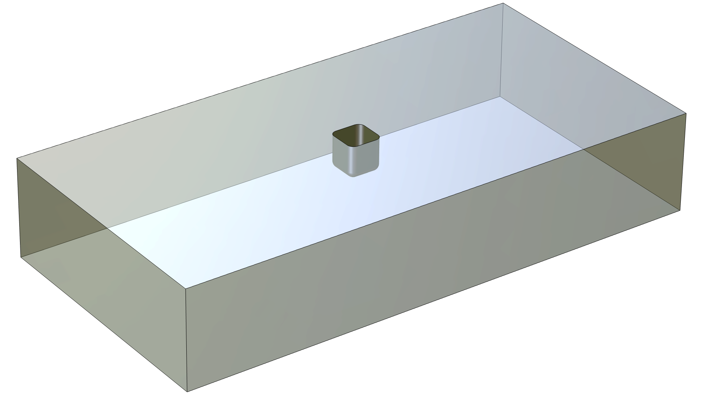
Geometry
groove surface
Small initial groove on the surface of the silicon wafer
When the groove surface comes into contact with the KOH solution, the groove grows due the chemical etching reaction

Slide 4
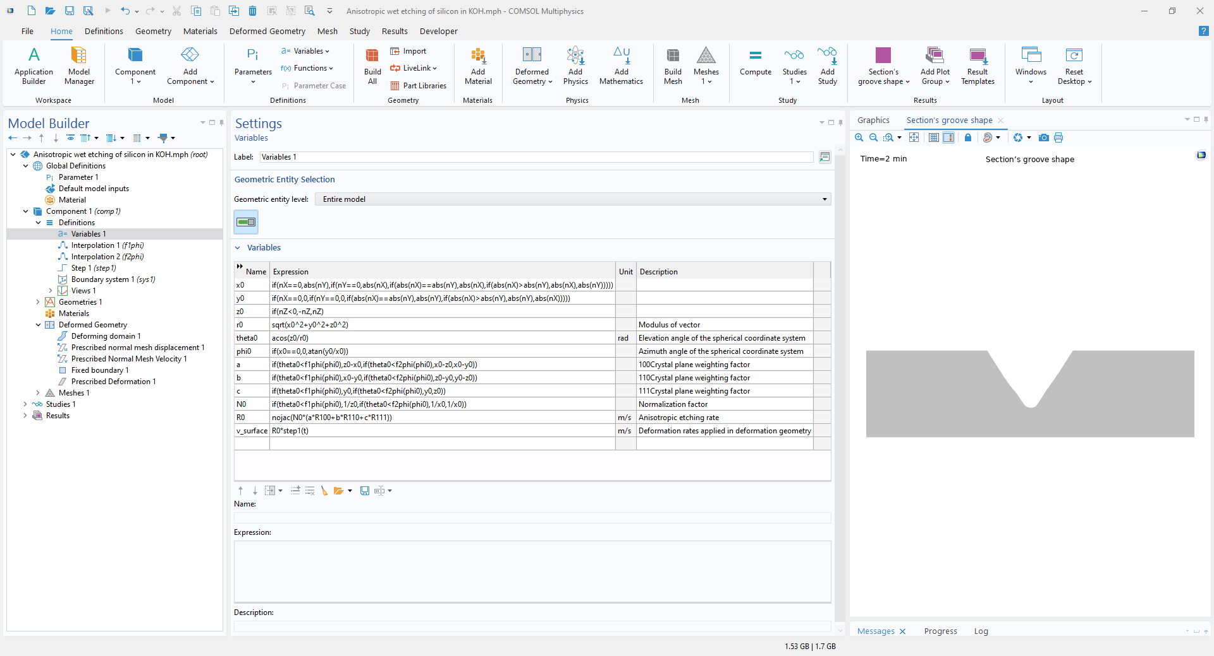
Interpolation Function Based on the Normal Angle of Etching Surface and the Etching Rate of the {100,110,111} Crystal Plane

Slide 5
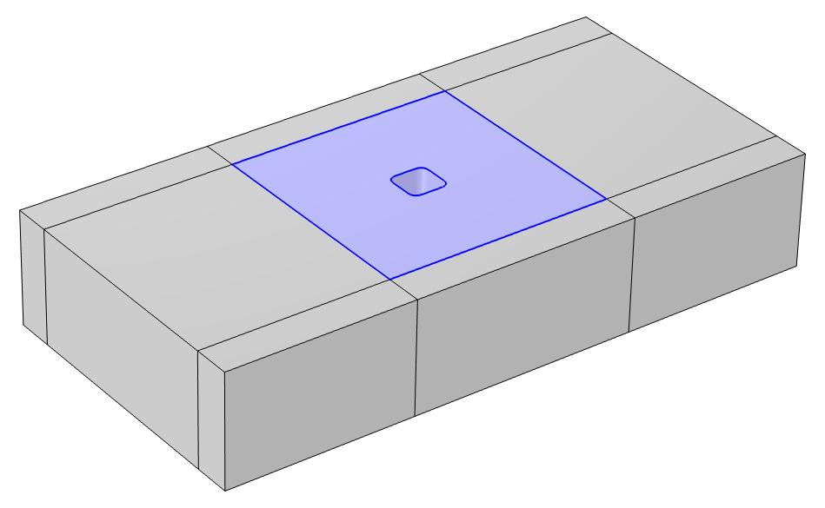
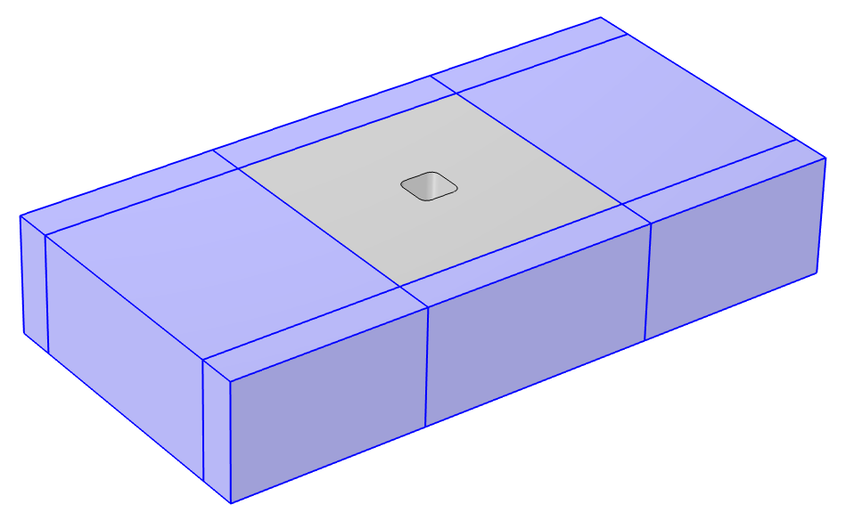
Deformed Geometry
Deforming Domain
Prescribed normal mesh velocity ：-v_surface
The Deformed Geometry feature is used
Domain Settings:
  Deforming Domain
  Fixed Domain
Boundary Conditions:
  Groove surface: Prescribed Normal Mesh Velocity = -v_surface
  Surface of the deforming domain: Prescribed Normal Mesh Displacement = 0
Prescribed normal mesh displacement: 0
Fixed Domain

Slide 6
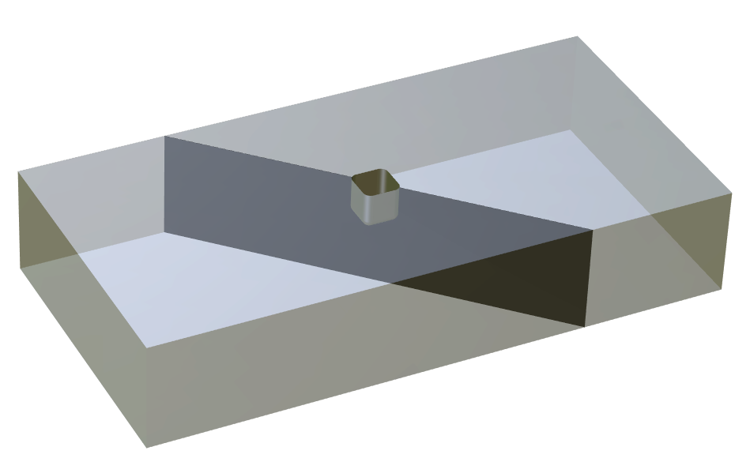

Results
45° oblique section
The shape of the etched groove change on the 45° oblique section
The etching depth increases gradually
Etching is slower in the {111} crystal plane direction
With the development of etching, V-shaped grooves are formed in the oblique plane
The angle between the inclined edge of the V-shaped groove and the upper line is about 55 °, which is close to the theoretical angle of 54.736 ° between the (111) crystal plane and the (100) crystal plane

Slide 7
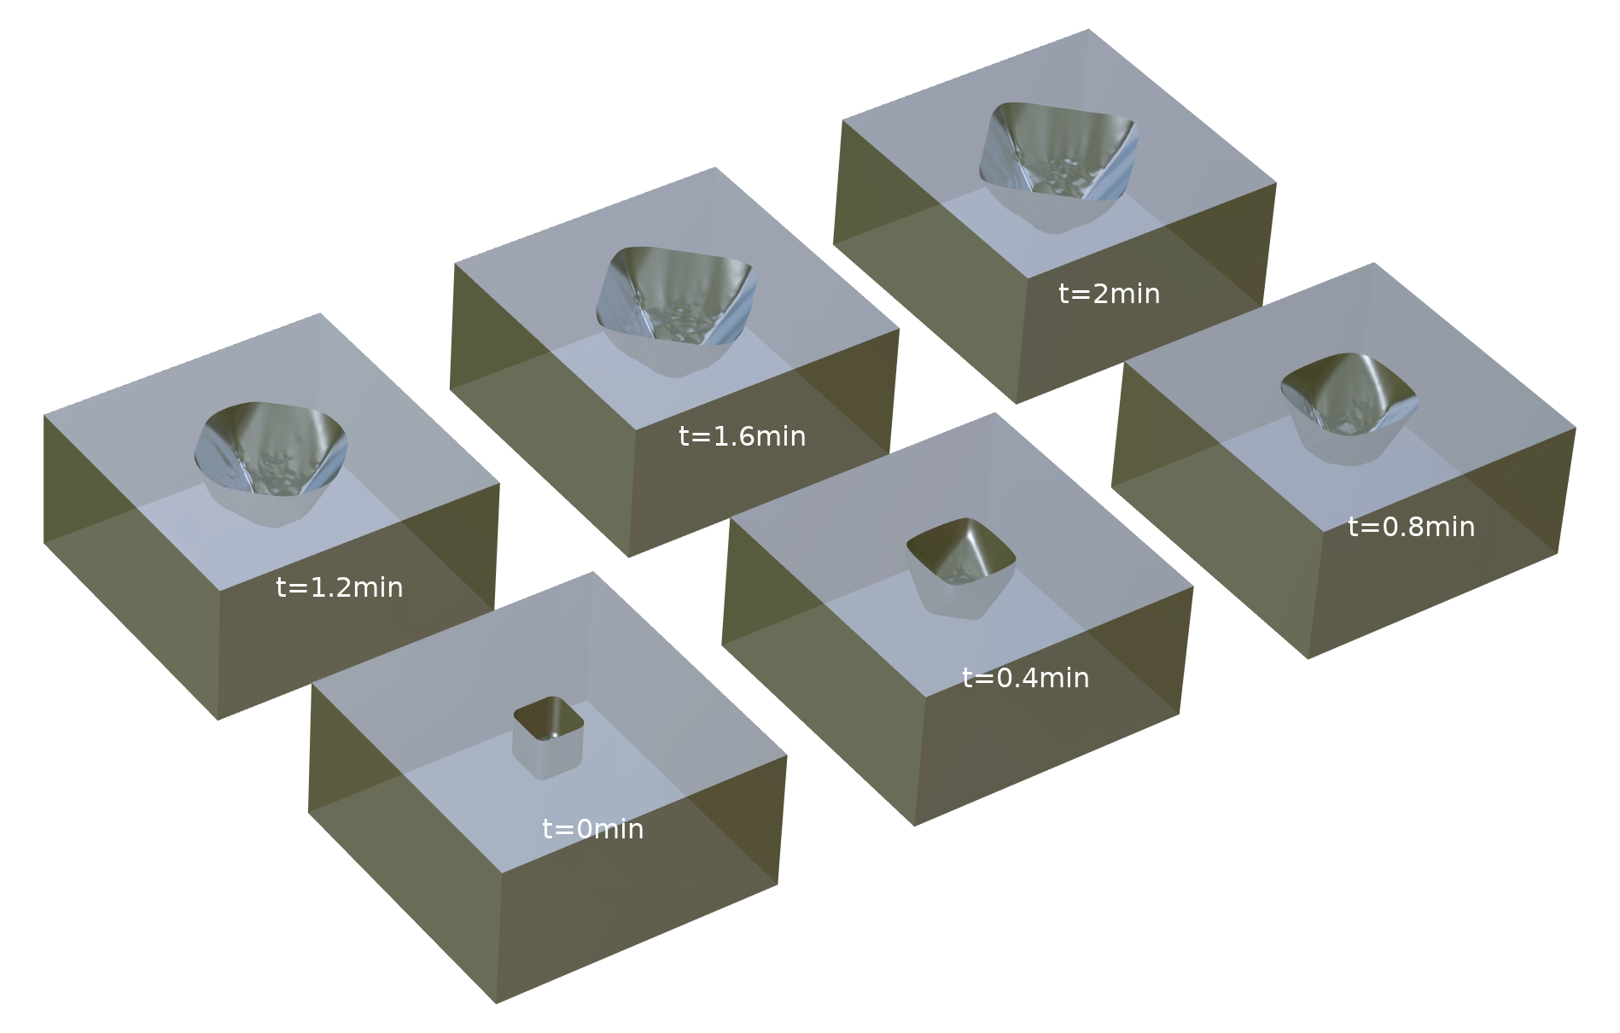
Results
Pyramid-shaped grooves are gradually formed with time
Etched groove shape with time in 3D.

Slide 8
Conclusions
With the help of COMSOL's deformation geometry feature and a custom variable function, anisotropic etching simulation of silicon in KOH can be achieved
Possible extension: The etching rate of the (311) crystal plane can be described using a detailed interpolation function in order to improve the model accuracy

