Slide 1
A Multiscale 3D Packed Bed Reactor

Slide 2
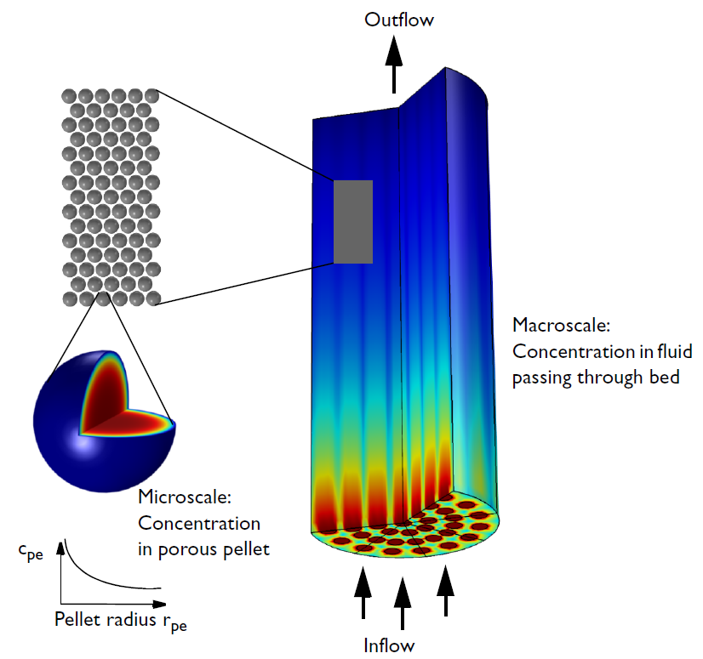

Modeling approach
An extra dimension approach to model the transport and reactions in a packed bed. The radial coordinate inside each pellet constitutes the extra 4th dimension through the “Reactive Pellet Bed” feature. The other 3 dimensions are the macroscopic bed.

Slide 3
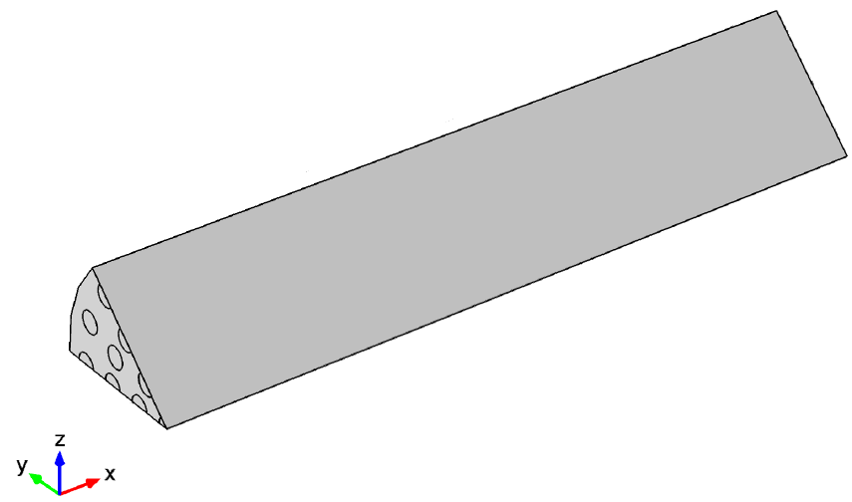
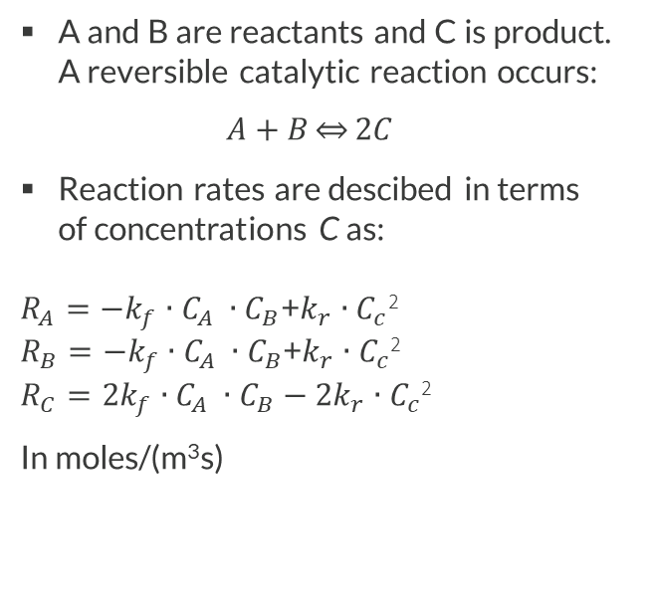
Reactions
A and B are reactants and C is product.
A reversible catalytic reaction occurs:
$A+B\underset{⇔}{}2C$
Reaction rates are descibed in terms
of concentrations C as:
$$R_{A}=−k_{f}∙C_{A} ∙C_{B}\text{+}k_{r}∙C_{c}\text{2}$$
$$R_{B}=−k_{f}∙C_{A} ∙C_{B}\text{+}k_{r}∙C_{c}\text{2}$$
$$R_{C}=2k_{f}∙C_{A} ∙C_{B}−{2k}_{r}∙C_{c}\text{2}$$
In moles/(m³s)
Symmetry cut
in macroscale geometry

Slide 4
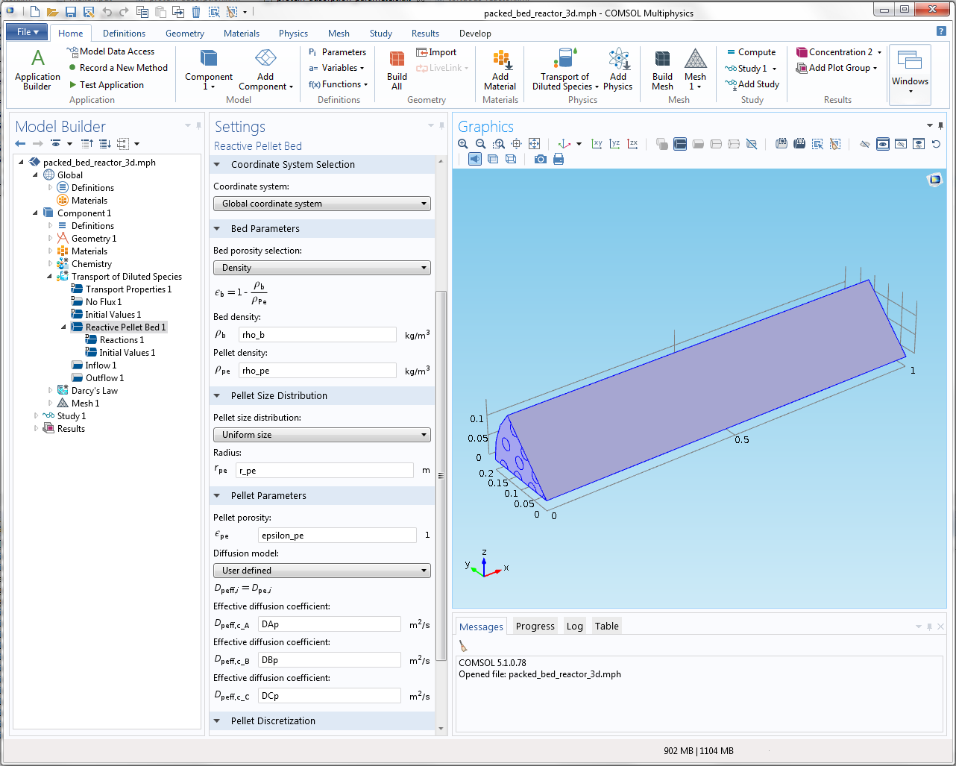
Reactive Pellet Bed feature available i Transport of Diluted Species
Packed pellet bed: Adds extra pellet dimension to problem

Slide 5
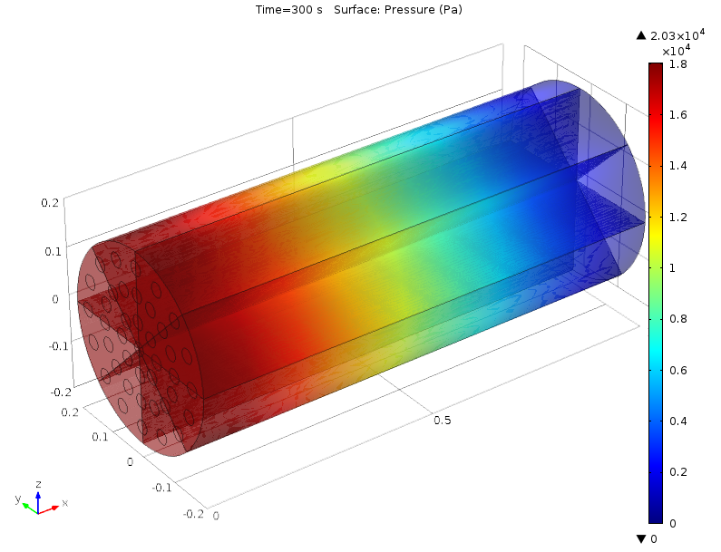
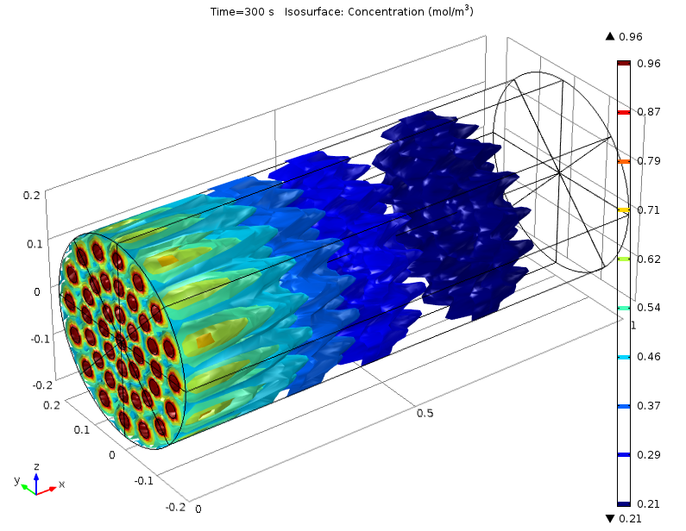
Results, macroscale
Bed pressure distribution, gauge pressure
Concentration distribution of reactant A in the macro space. A is consumed by the pellet reactions along the flow path

Slide 6
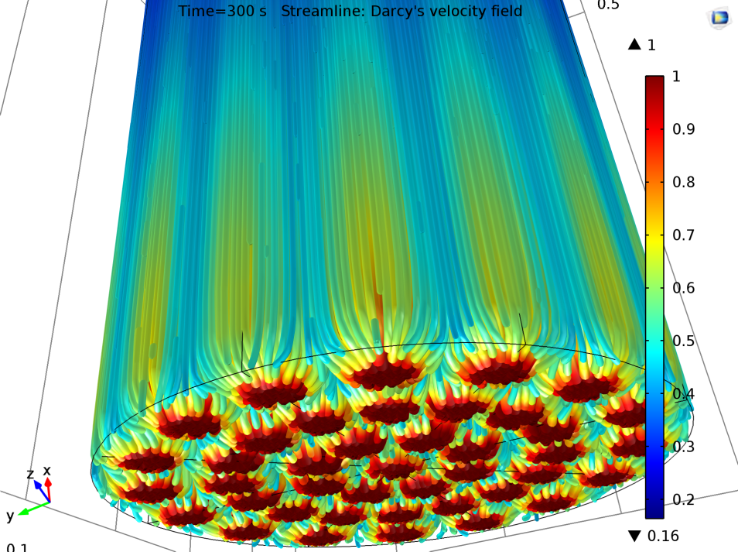
Results, macroscale
Velocity streamlines at the bottom part. Colors denote the concentration of diol monomer in moles/m³

Slide 7
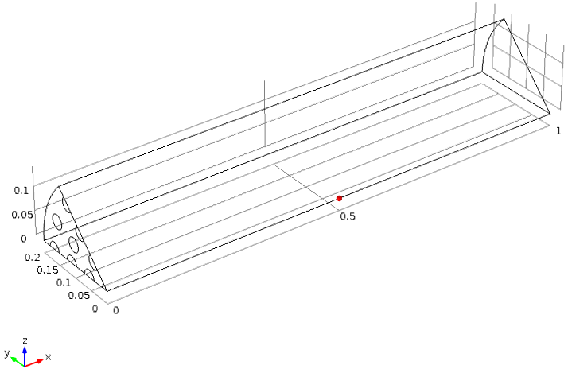
Results, microscale
Example plots of the pellet concentrations
at center of column, at 0.5 m height position

Slide 8
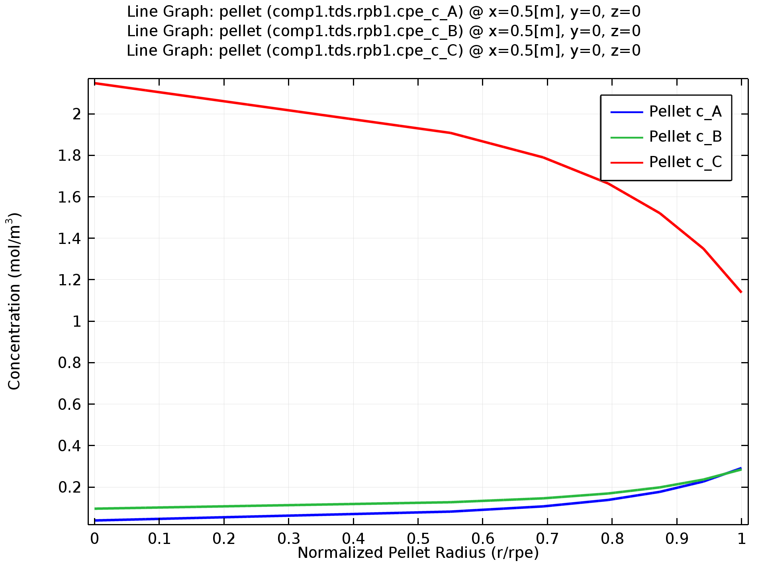
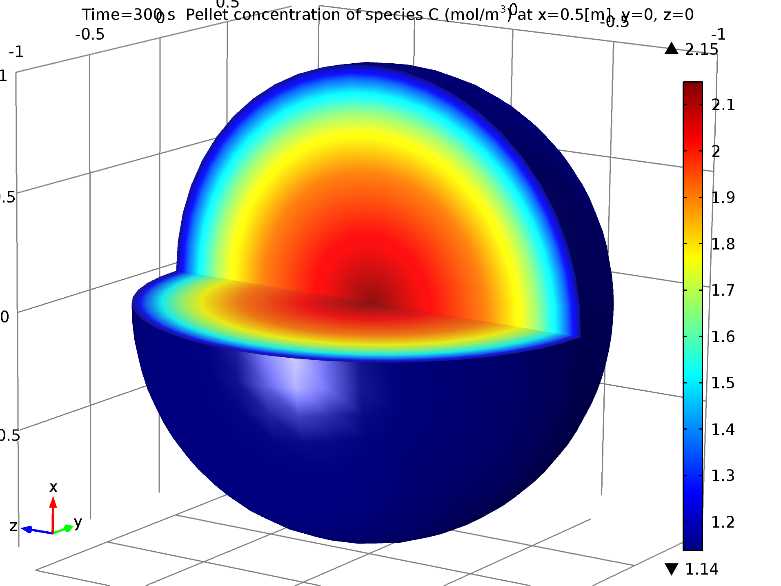
Results, microscale
Concentration distibution in one catalytic pellet: The product C has a higher concentration at the center, showing that product exits the pellet at the surface during reaction
3D representation of the product concentration

