Slide 1

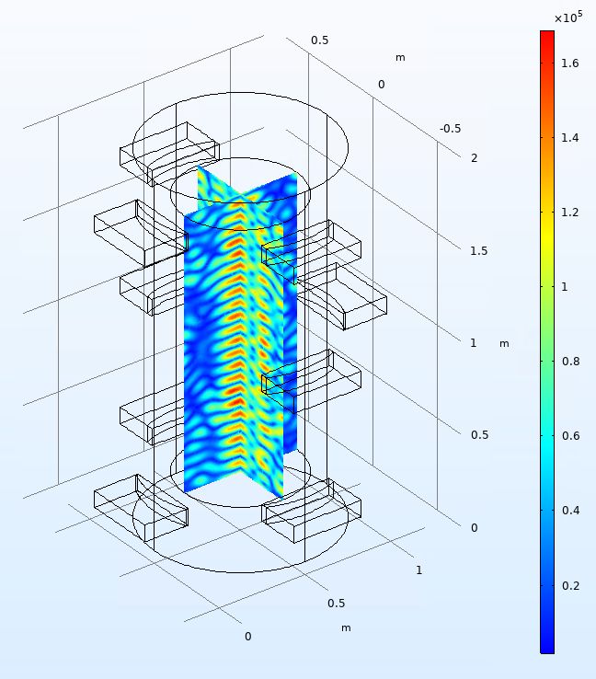
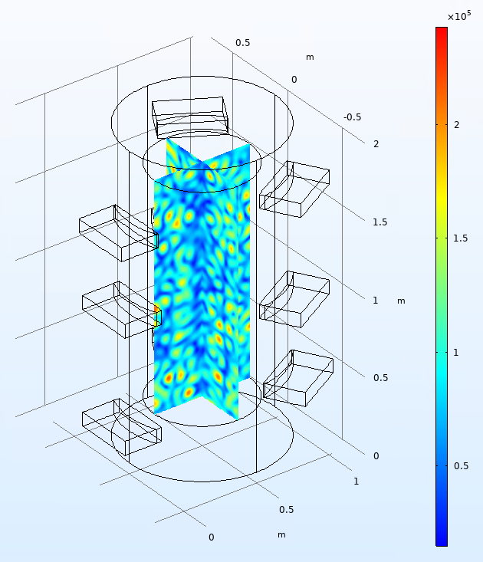
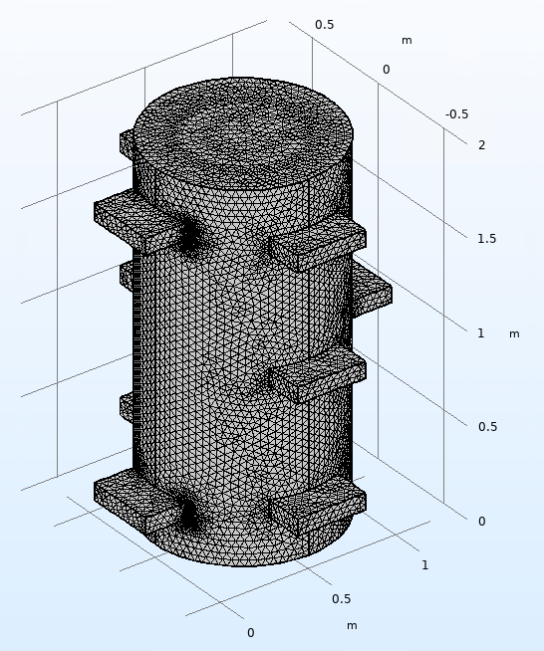
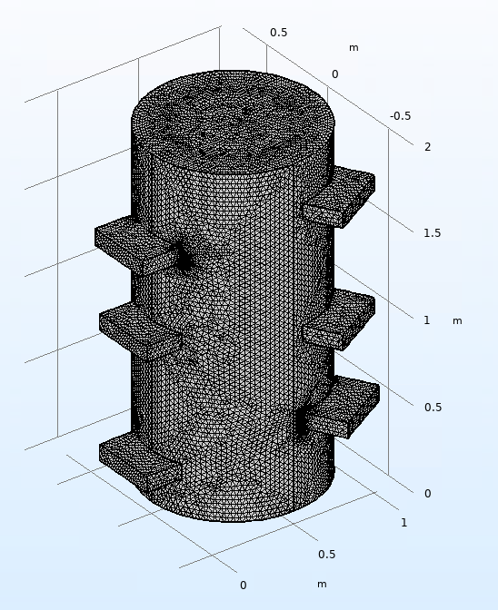

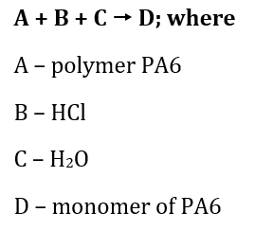
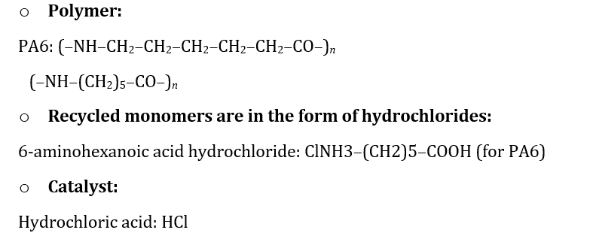
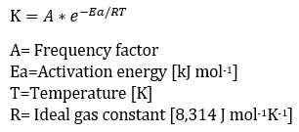
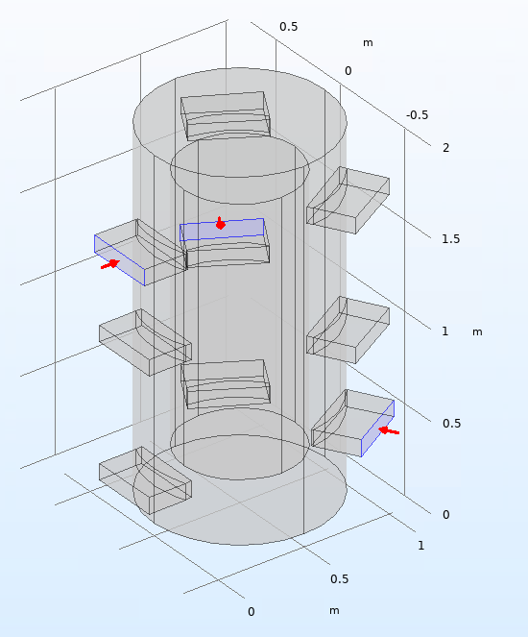
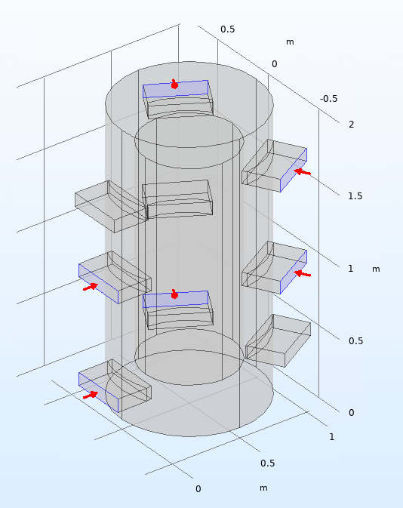

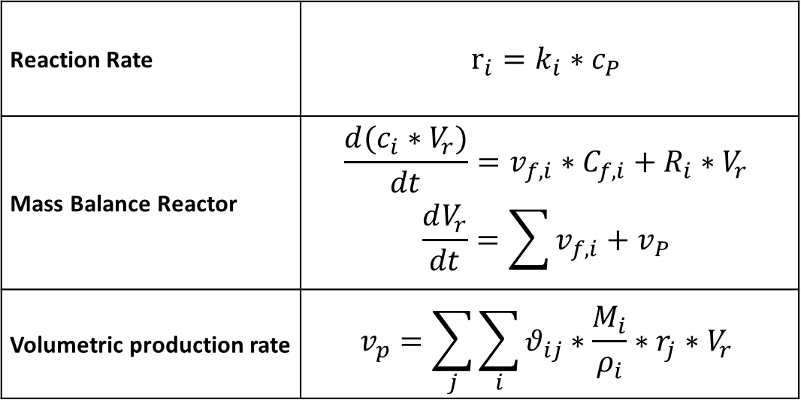
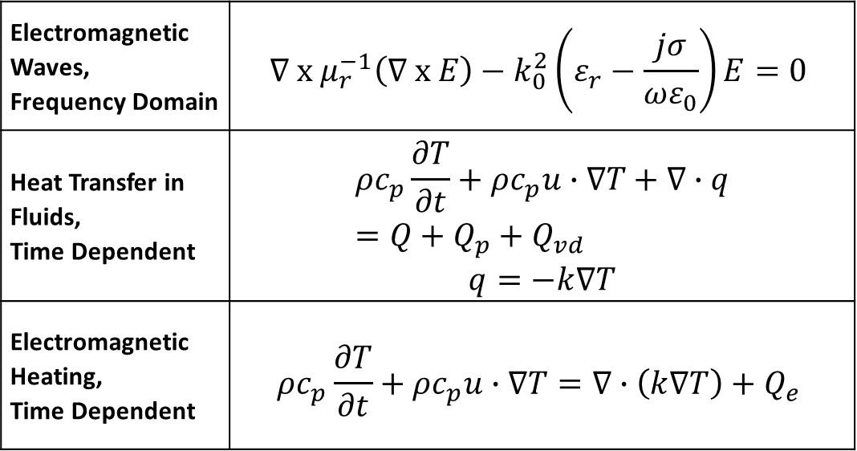
Multi-frequency design of and optimized microwave cavity for plastic recycling applications
A. Frisa¹, L. Royo-Pascual^{1*}, J. Consejo¹ , T. García-Armingol¹
1. Fundación CIRCE, Parque Empresarial Dinamiza Avda. de Ranillas 3D, 1º Planta, 50018 Zaragoza, Spain
INRODUCTION: The purpose of the current work is to design and optimize the physical process of material heating inside a reactor using 9 ports emitting electromagnetic waves. Although several works are available in the literature concerning single-frequency simulation (S-F) for different geometries and applications [1]–[2], few papers are available using a multi-frequency (M-F) simulation. Therefore, this poster focuses on the 3D simulation of a reactor cavity using two levels of frequency (915 MHz and 2.45 GHz) with a power level of 51 kW for depolymerization purposes. The depolymerization process of PA6, PA66 and PU has been also simulated using COMSOL software.
RESULTS: The main expected results consist of:
Homogenization of the EM field distribution after the sensitivity study analysis varying the frequency, number of ports and position.
Decrease of heating time required to reach objective temperature : (170-200 ̊C).
Optimization of temperature distribution inside reactor, specially focused on hotspots distribution.
Depolymerization simulation of PA6, PA66 and PU.
Figure 3. S-F MW reactor
(2.45 GHZ)
Figure 4. M-F MW reactor
(915 MHz+2.45 GHz)
Figure 1. Reactor Design optimization procedure
COMPUTATIONAL METHODS: In order to simulate the reactor and the depolymerization, two different COMSOL Multiphysics modules are used in this work: Radio Frequency (RF) and Reaction Engineering (RE). In RF module, Maxwell equations, Poynting theorem and energy conservation law are used to simulate electromagnetic heating process. In the RE module, the reaction rate, mass balance and volumetric production are used to simulate the depolymerization of polymers.
a)
b)
Table 1. RF equations
Table 2. RE equations
Figure 5. Depolymerization of PA6: a)Simulation b)Experimental results
Electromagnetic Waves, Frequency Domain | $$∇ x μ_{r}^{−1}\left(∇ x E\right)−k_{0}^{2}\left(ε_{r}−\frac{jσ}{ωε_{0}}\right)E=0$$
Heat Transfer in Fluids, Time Dependent | $$ρc_{p}\frac{∂T}{∂t}+ρc_{p}u∙∇T+∇∙q=Q+Q_{p}+Q_{vd}$$ $$q=−k∇T$$
Electromagnetic Heating, Time Dependent | $$ρc_{p}\frac{∂T}{∂t}+ρc_{p}u∙∇T=∇∙\left(k∇T\right)+Q_{e}$$
Reaction Rate | $$r_{i}=k_{i}∗c_{P}$$
Mass Balance Reactor | $$\frac{d(c_{i}∗V_{r})}{dt}=v_{f,i}∗C_{f,i}+R_{i}∗V_{r}$$ $$\frac{dV_{r}}{dt}=\sum{v_{f,i}+v_{P}}$$
Volumetric production rate | $$v_{p}=\sum_{j}{\sum_{i}{θ_{ij}∗\frac{M_{i}}{ρ_{i}}∗r_{j}∗V_{r}}}$$
CONCLUSIONS: A complex physical system was reduced to two different mathematical models, taking advantage in design stage and process configuration. The result will allow to develop a new microwave system focused in a novel industrial process. Future direction will address the total coupling between heating and chemical process.
REFERENCES:
[1] E. Ethridge and W. Kaukler, “Finite Element Analysis of Three Methods for Microwave Heating of Planetary Surfaces,” 2014.
[2] D. S. Rajpurohit and R. Chhibber, “Design Optimization of Two Input Multimode Applicator for Efficient Microwave Heating,” Int. J. Adv. Microw. Technol., vol. 1, no. 3, pp. 68–73, 2016.
AKNOWLEDGEMENTS:
The project has received funding from European Union’s Horizon 2020 research and innovation program under the grant agreement No 820665-polynSPIRE project. This publication reflects some preliminary results from a MW simulation required inside the H2020 polynSPIRE project, focused on technologies of plastic recycling.
a)
b)
Figure 2. Definition of ports: a) 915 MHz b) 2.45 GHz
Excerpt from the Proceedings of the 2019 COMSOL Conference in Cambridge

